Slide 1
Welcome to Azure Defender + Azure Sentinel Better Together! Day 2

Slide 2
A look into Day 2
Kick-Off | 8:00-8:05 | Welcome | Main Call
 | 8:05-8:30 | Azure Sentinel
 | 8:30-8:45 | Demo Walkthrough
Ingest | 8:45-9:00 | Break
 | 9:00-10:00 | Azure Sentinel Part I
 | 10:00-11:00 | Activity: Azure Sentinel Considerations | Table Group Call
 | 11:00-11:15 | Break
 | 11:15-12:00 | Build Hands-on: Azure Sentinel Part 1 | Table Group Call
Transform | 12:00-1:00 | Break | Main Call
 | 1:00-1:30 | Security Operations Center
 | 1:30-2:00 | Activity: Security Operations Center
 | 2:00-3:00 | Build Hands-on: Azure Sentinel Part 2 | Table Group Call
 | 3:00-:15 | Closing | Main Call
Today we will be learning and collaborating across three spaces:
Main call (this meeting)
Table Group channel within the event Team
CloudLabs Learner Portal & Lab environment
Presentation/
Whole Group
Lab
Activity/ Discussion/ Group Work
Announcements

Slide 3
Azure Defender + Azure Sentinel Better Together!

Slide 4
Azure Sentinel

Slide 5

Azure Sentinel
Scalable, cloud-native, security information event management (SIEM) and security orchestration automated response (SOAR) solution. Azure Sentinel delivers intelligent security analytics and threat intelligence across the enterprise, providing a single solution for alert detection, threat visibility, proactive hunting, and threat response.
Azure Sentinel is your birds-eye view across the enterprise alleviating the stress of increasingly sophisticated attacks, increasing volumes of alerts, and long resolution time frames.
Notes:
TODO

Slide 6
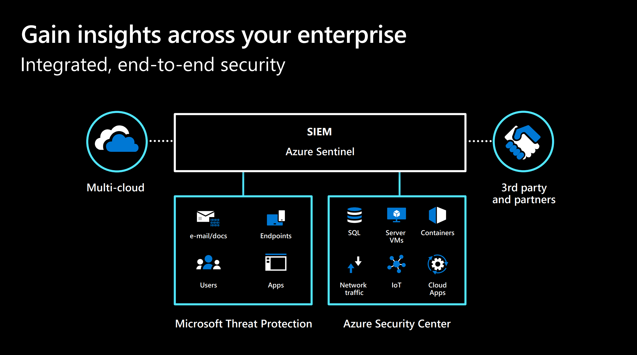

Slide 7


Slide 8


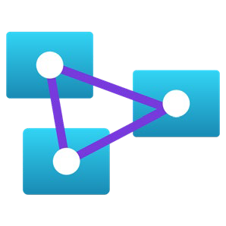


Latest innovations
Helping you stay ahead of threats
Analytics
Behavioral Analytics (UEBA) Entity Search and Profiles New ML Fusion Scenarios
Jupyter Notebooks Powered by Azure ML
Intelligence
Threat Indicator Management Integrated Threat Intelligence from Threat
Quotent, Recorded Future, RiskIQ
Watchlists
Data Collection
Network Schema (OSSEM) Logstash Output Plug-In
Connectors for: Microsoft Teams, Microsoft 365 Defender Endpoint, CyberArk, NetScaler, ForgeRock, & Beyond Security

Slide 9






End-to-end solution for security operations
Detect
Collect
Visibility
Investigate
Incidents
Respond
Automation
Analytics
Hunting
Powered by community + backed by Microsoft’s security experts

Slide 10

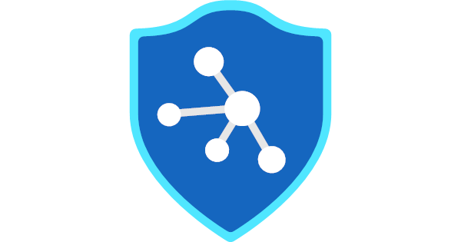
Azure Sentinel vs Azure Security Center with Azure Defender
Cybersecurity Cycle
Visibility
Analytics
Hunting
Incidents
Automation
Azure Security Center
Azure Sentinel

Slide 11
Azure Sentinel
Things that you can NOT do:
You can NOT use the same Log Analytics Workspace that is used by Azure Security Center
Once Azure Sentinel is enabled on a workspace, you can NOT move the workspace to another resource group or subscription (you have to contact Azure Sentinel Support Team to accomplish this task)
Notes:
TODO

Slide 12
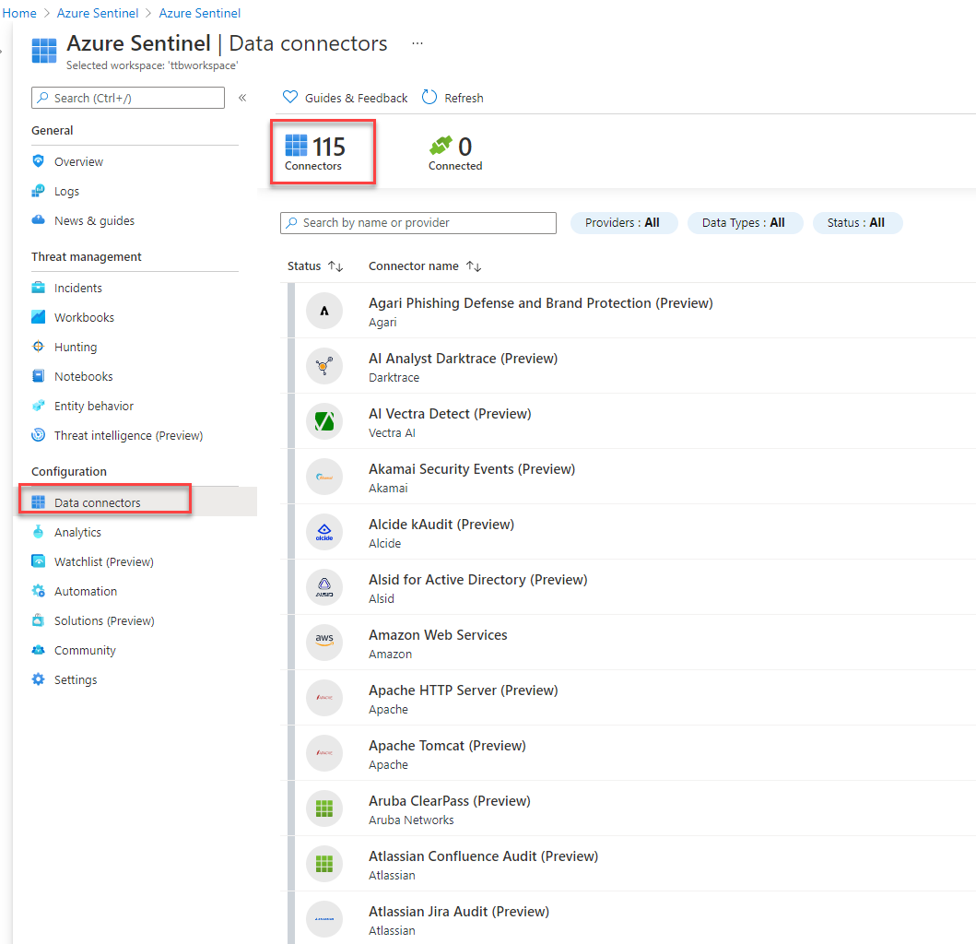
Azure Sentinel - Connectors
Over 100+ Data Connectors available for Azure Sentinel
Not only for Azure connection but external services as well.
Notes:
TODO

Slide 13
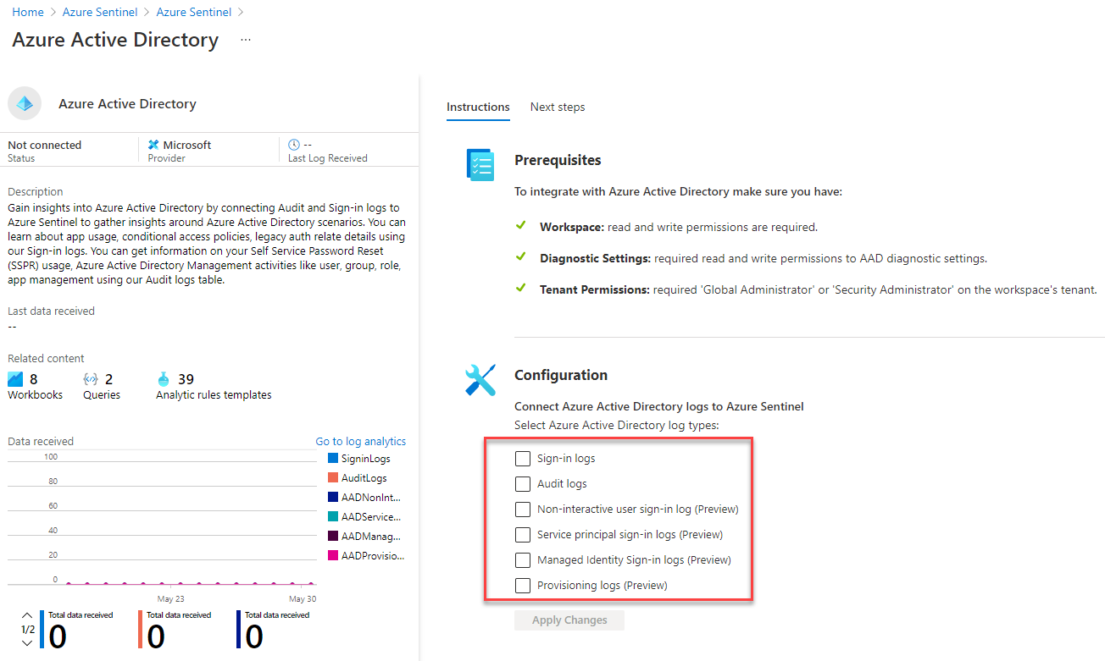
Azure Sentinel - Connectors
Example: Azure Active Directory Connector:
Notes:
TODO

Slide 14
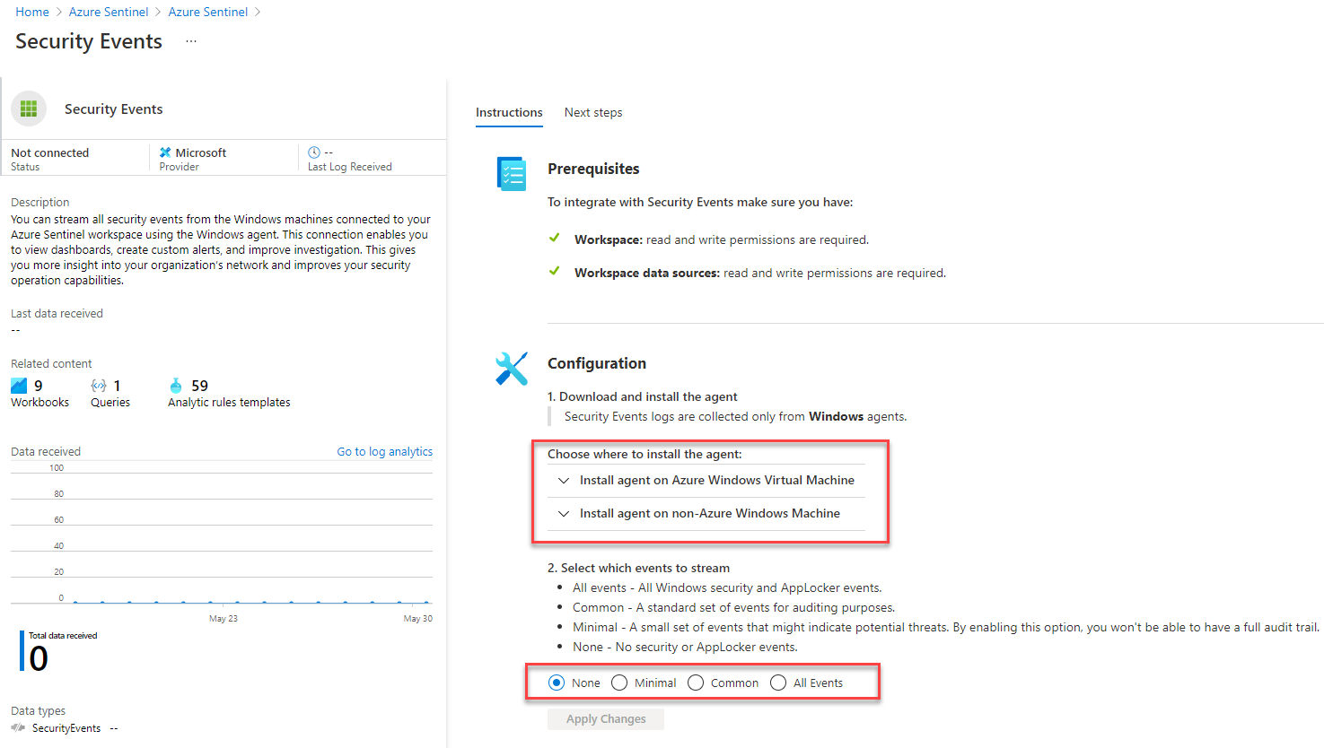
Azure Sentinel - Connectors
Example: Security Events Connector:
Notes:
TODO

Slide 15
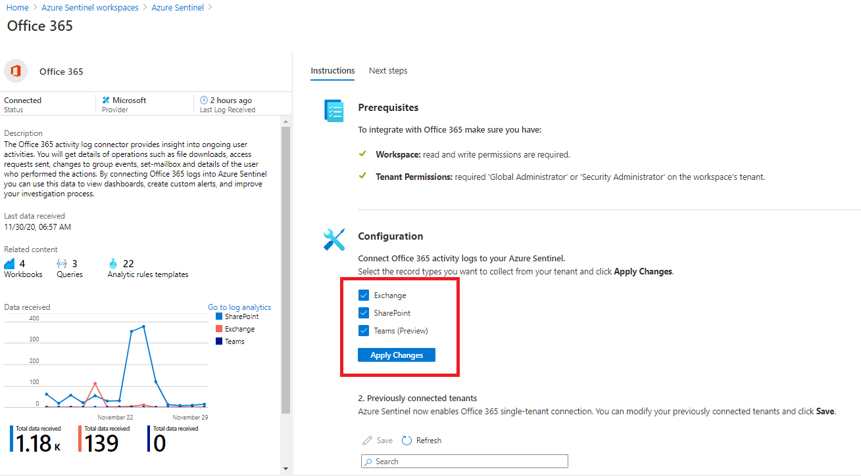
Azure Sentinel - Connectors
Example: Office 365
Notes:
TODO

Slide 16
Azure Sentinel - Incidents
Azure Sentinel incidents are containers of threats in your organization – alerts, entities and any additional related evidence.
An incident is created based on alerts that you have defined in the security analytics page. The properties related to the alerts, such as severity and status are set at the incident level.
Activities related to events include:
View related alerts - View all related alerts that are aggregated into an incident based on the alert trigger definition of the alert fusion strategy enabled
Triage and investigate - Review all related entities in the incident and additional contextual information meaningful to the triage process.
Incident Management - Manage the lifecycle of the incident – assign to yourself for further investigation, change the status of the incident and update its severity after triage.
Respond to alerts - Trigger playbooks on the alerts grouped in the incident to resolve the threat detected by the alert using playbooks.
Notes:
TODO

Slide 17
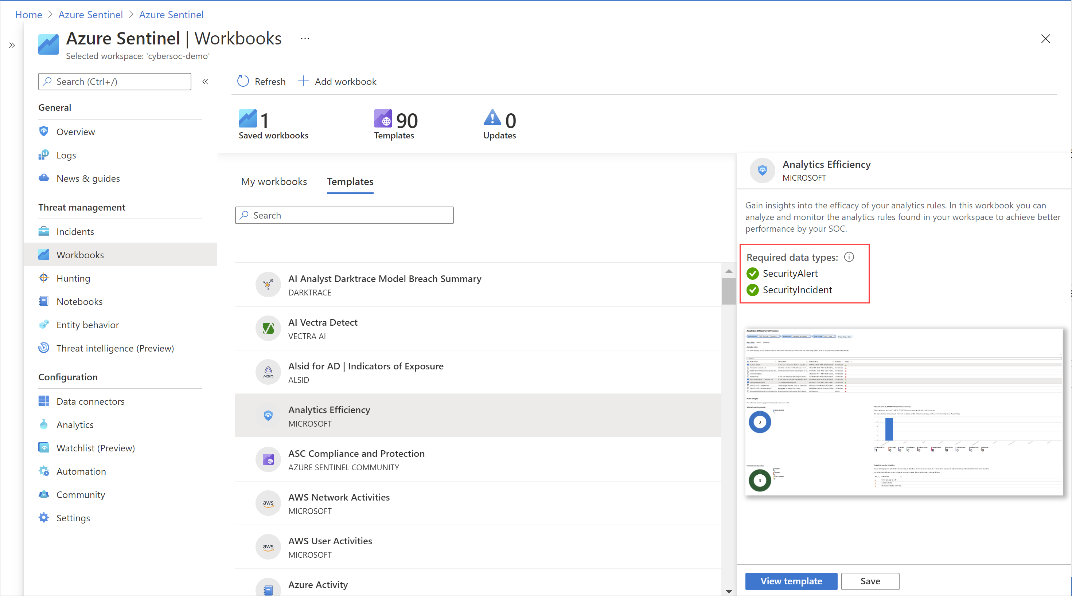
Azure Sentinel - Workbooks
Azure Sentinel integrates with Azure Monitor Workbooks
You can create Workbooks across your Data
Azure Sentinel comes with Workbook templates to allow for quick insight gain right after connecting the data.
Notes:
TODO

Slide 18
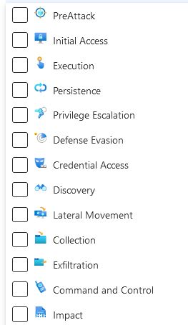
Azure Sentinel - Hunting
Over 195 pre-defined queries helpful for hunting for potential threats in your log data
Defined based on the MITRE ATTACK framework tactics and techniques
Keeps track of deltas (previous results)
Queries should not have time defined in the KQL query
Livestream allows for a user session-based, user interface driven feature that allows an Azure Sentinel user to quickly create a Livestream session using any Log Analytics query.
Test newly created queries, elevate to alerts once tested
Allows for quick testing without custom alert rule overhead
Target an entity for live streaming during an investigation
https://github.com/Azure/Azure-Sentinel/tree/master/Hunting%20Queries
Notes:
https://docs.microsoft.com/en-us/azure/sentinel/hunting
https://github.com/Azure/Azure-Sentinel/tree/master/Hunting%20Queries

Slide 19

Azure Sentinel - Notebooks
Julia Python and R ➔ Jupyter Notebooks
When to use Notebooks in Sentinel?
When triaging an incident in Azure Sentinel comes to a dead end.
Your investigation become significantly more complex
When automation ends and there is a need to find a needle in a haystack
Too much details to go through
Need persistence to pass results to the next analyst
KQL is no longer cutting it
Need to integrate with external data (WhoIs, GeoIP, etc…) not stored in the workspace
Need for ML and visualizations available already in the form of 1000s of libraries and packages.
Notes:
Notebooks in Azure Sentinel are based on Jupyter notebooks based on Julia Python and R languages.

Slide 20
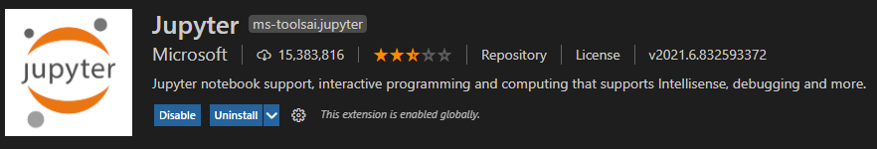
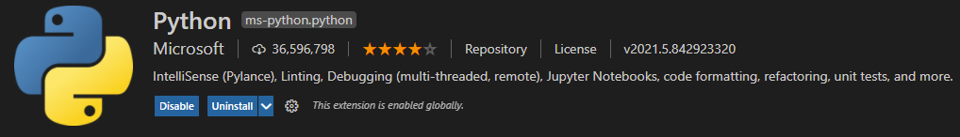
Azure Sentinel – Notebooks …
You can use Visual Studio Code to develop your Notebooks.
You can use a Local Docker Container to developer locally disconnected.
You can use %kql as a magic command to continue using your queries in the notebooks

Slide 21
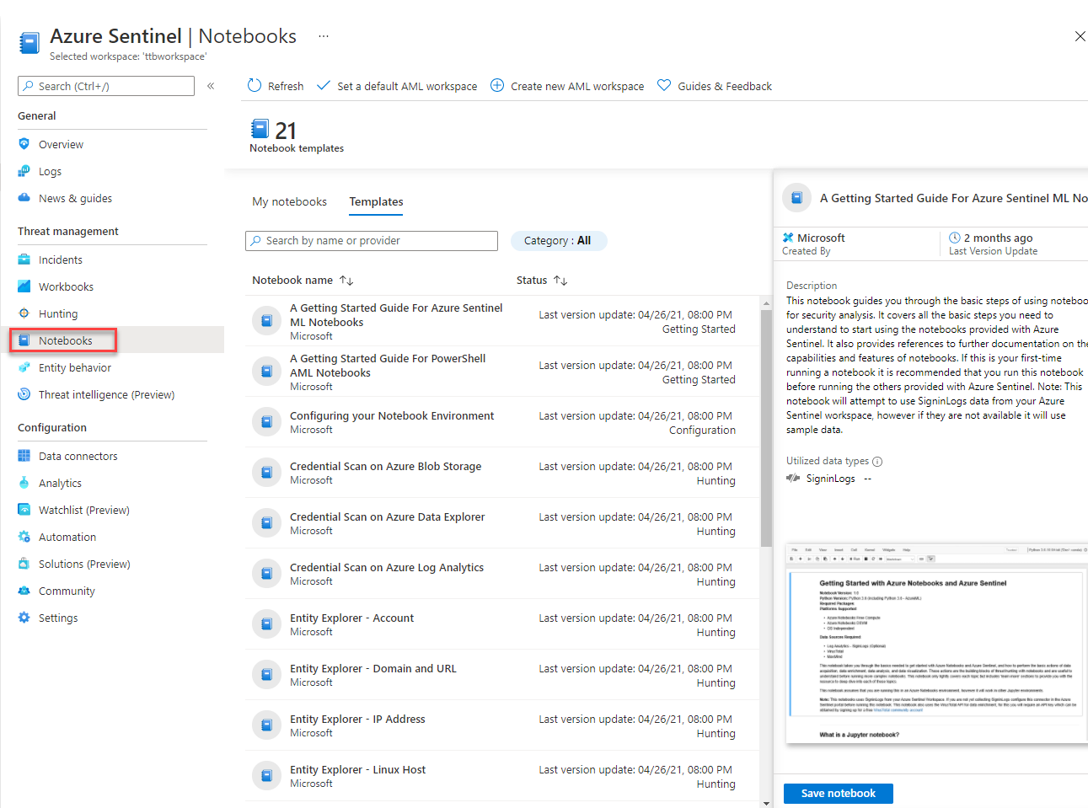
Azure Sentinel – Notebooks …

Slide 22
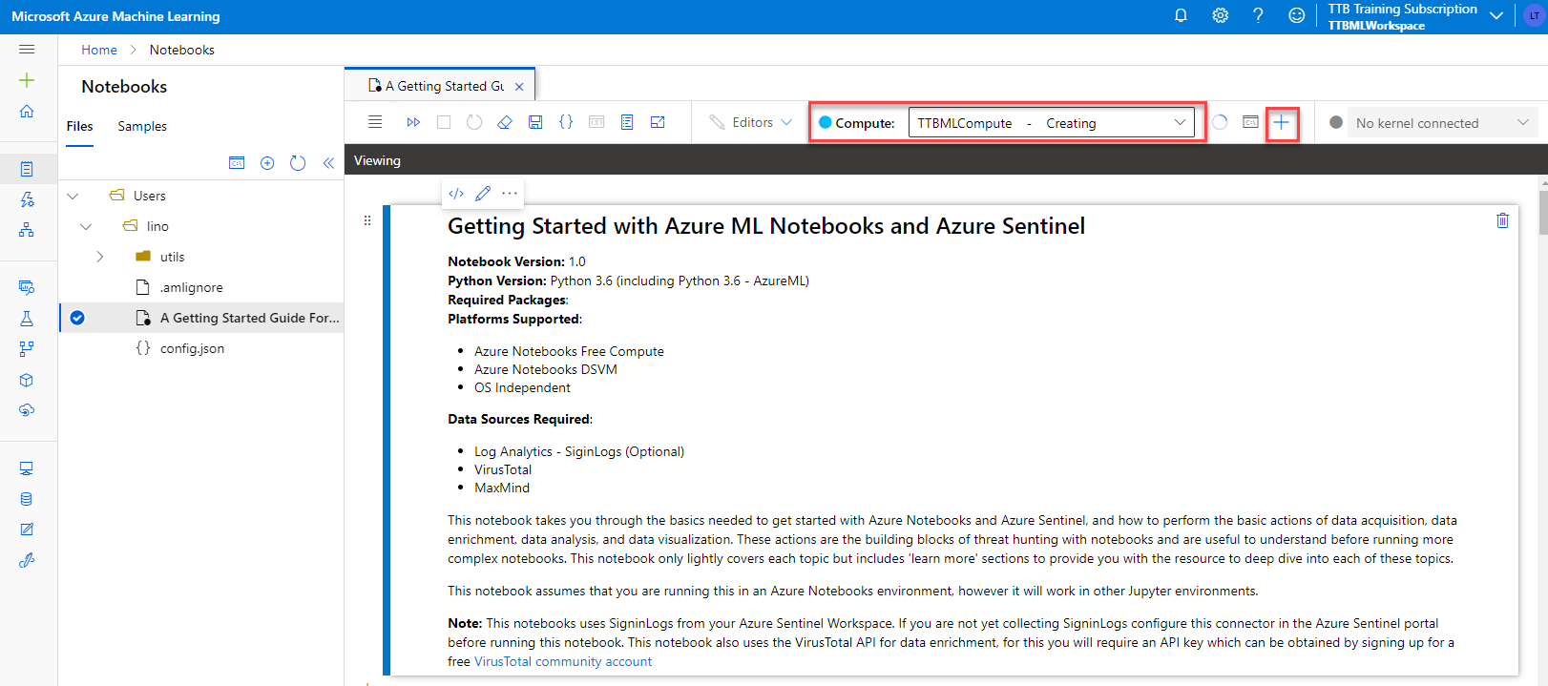
Azure Sentinel – Notebooks …
Notes:
Choosing the ML Template Notebook to use with Azure Sentinel
You have to choose a Compute to start using the Notebook
You will need to Authenticate from the notebook to use any Azure SDK

Slide 23
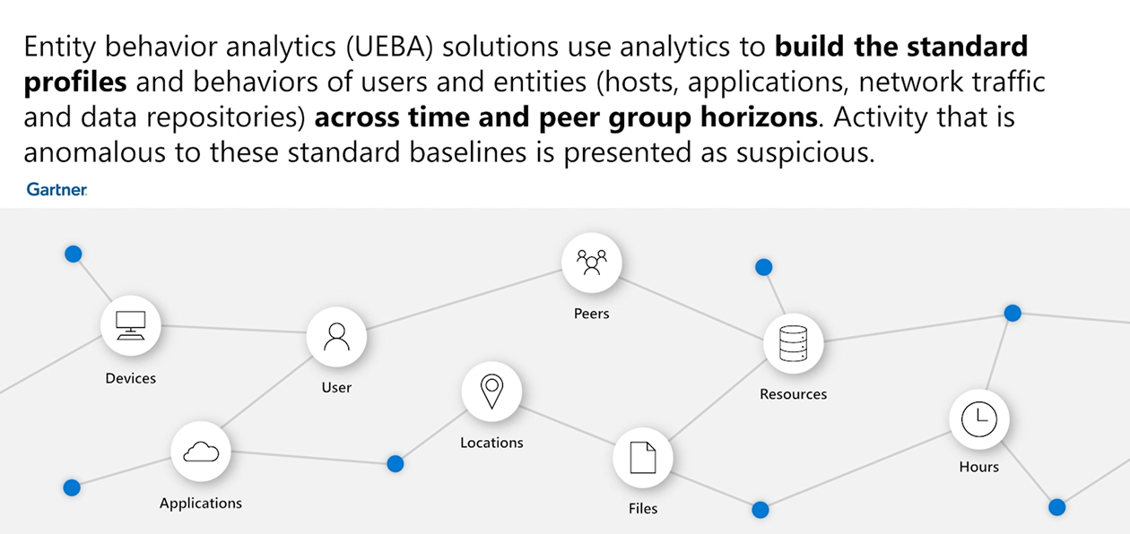
Azure Sentinel – Entity Behavior
Notes:
TODO

Slide 24
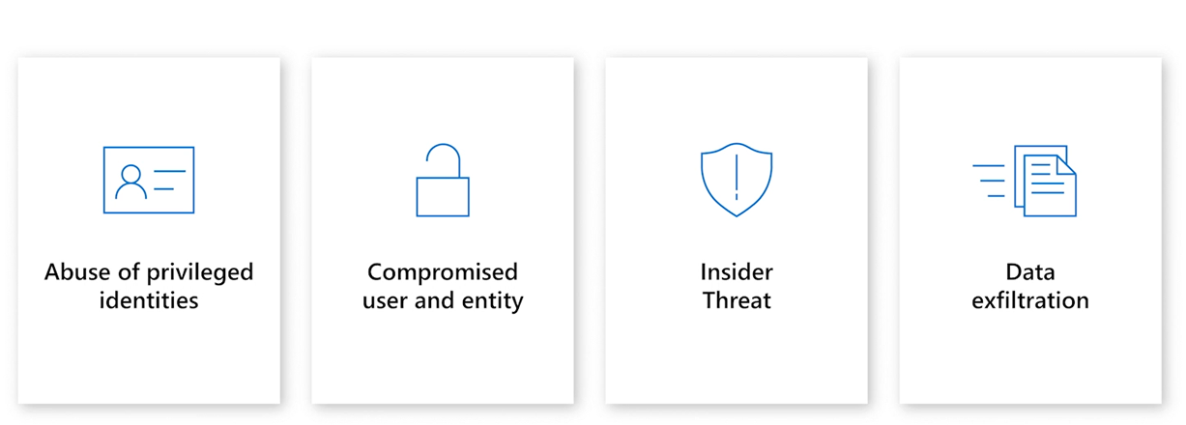
Azure Sentinel – Entity Behavior – Use Cases
Notes:
TODO

Slide 25
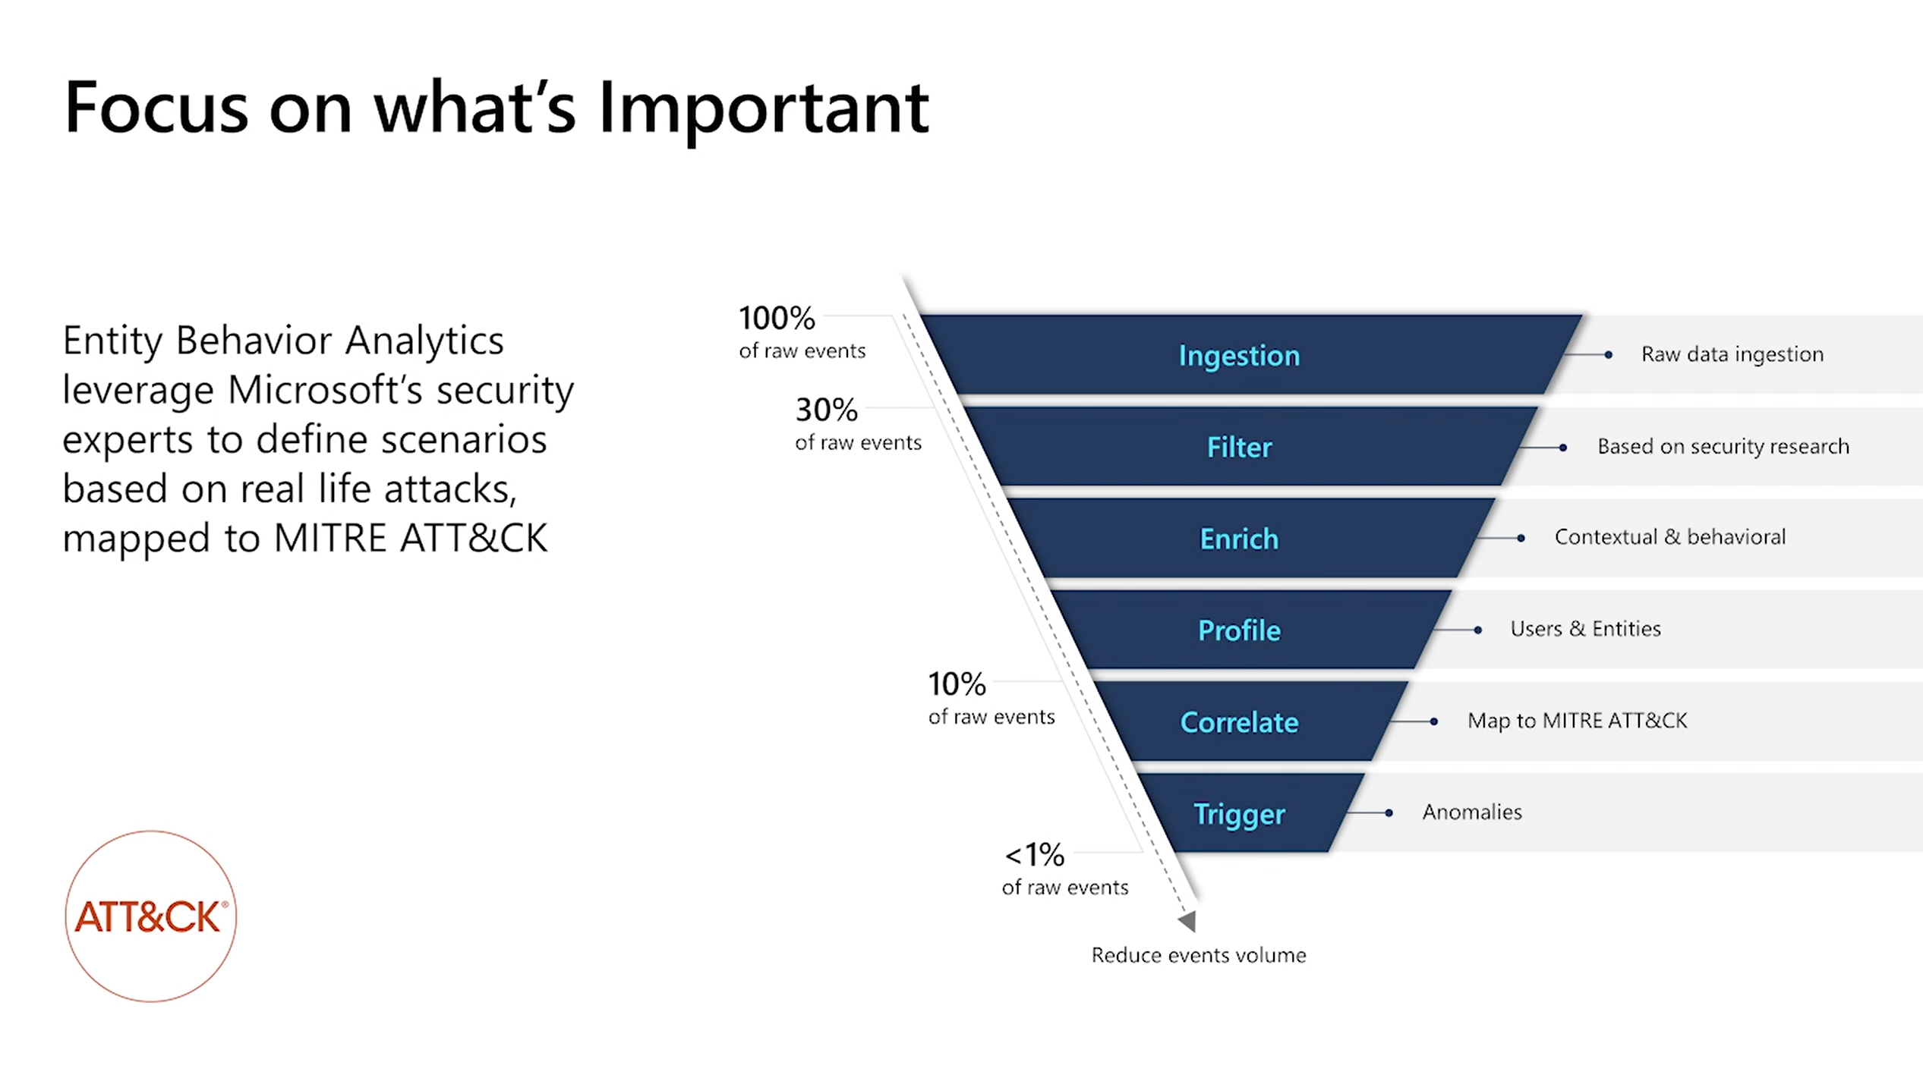

Slide 26
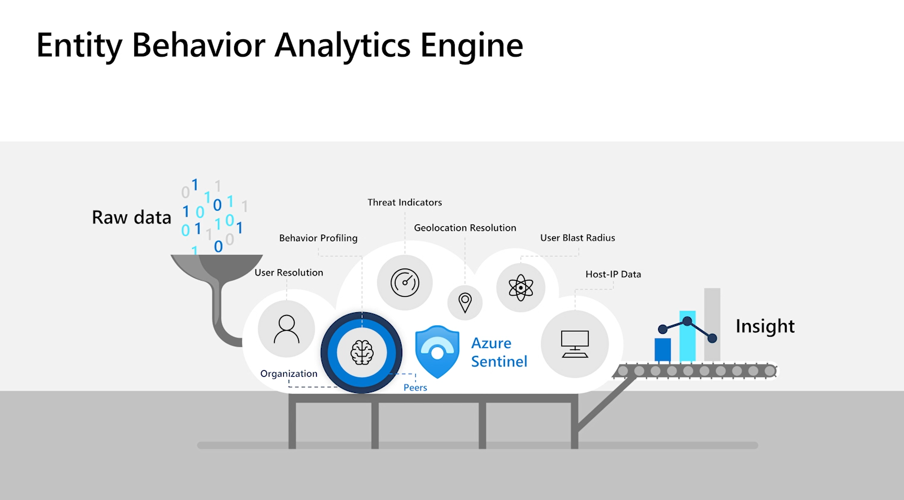

Slide 27
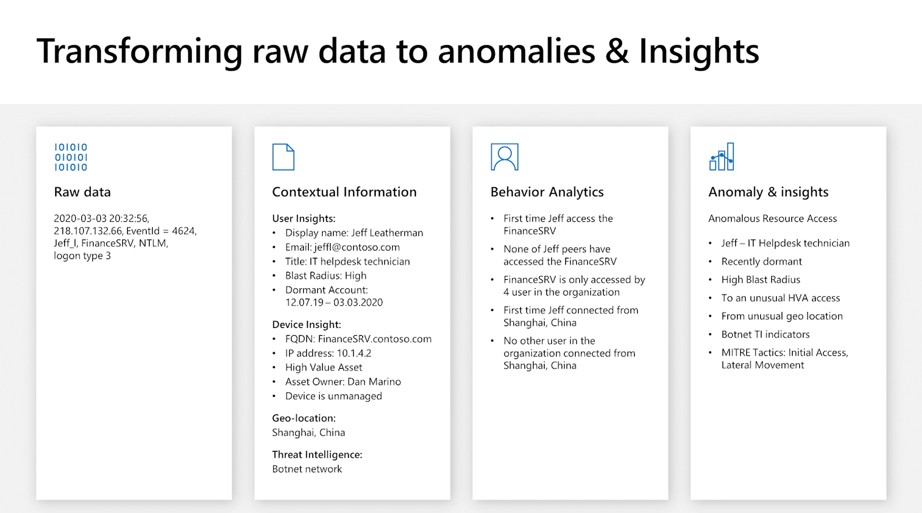

Slide 28
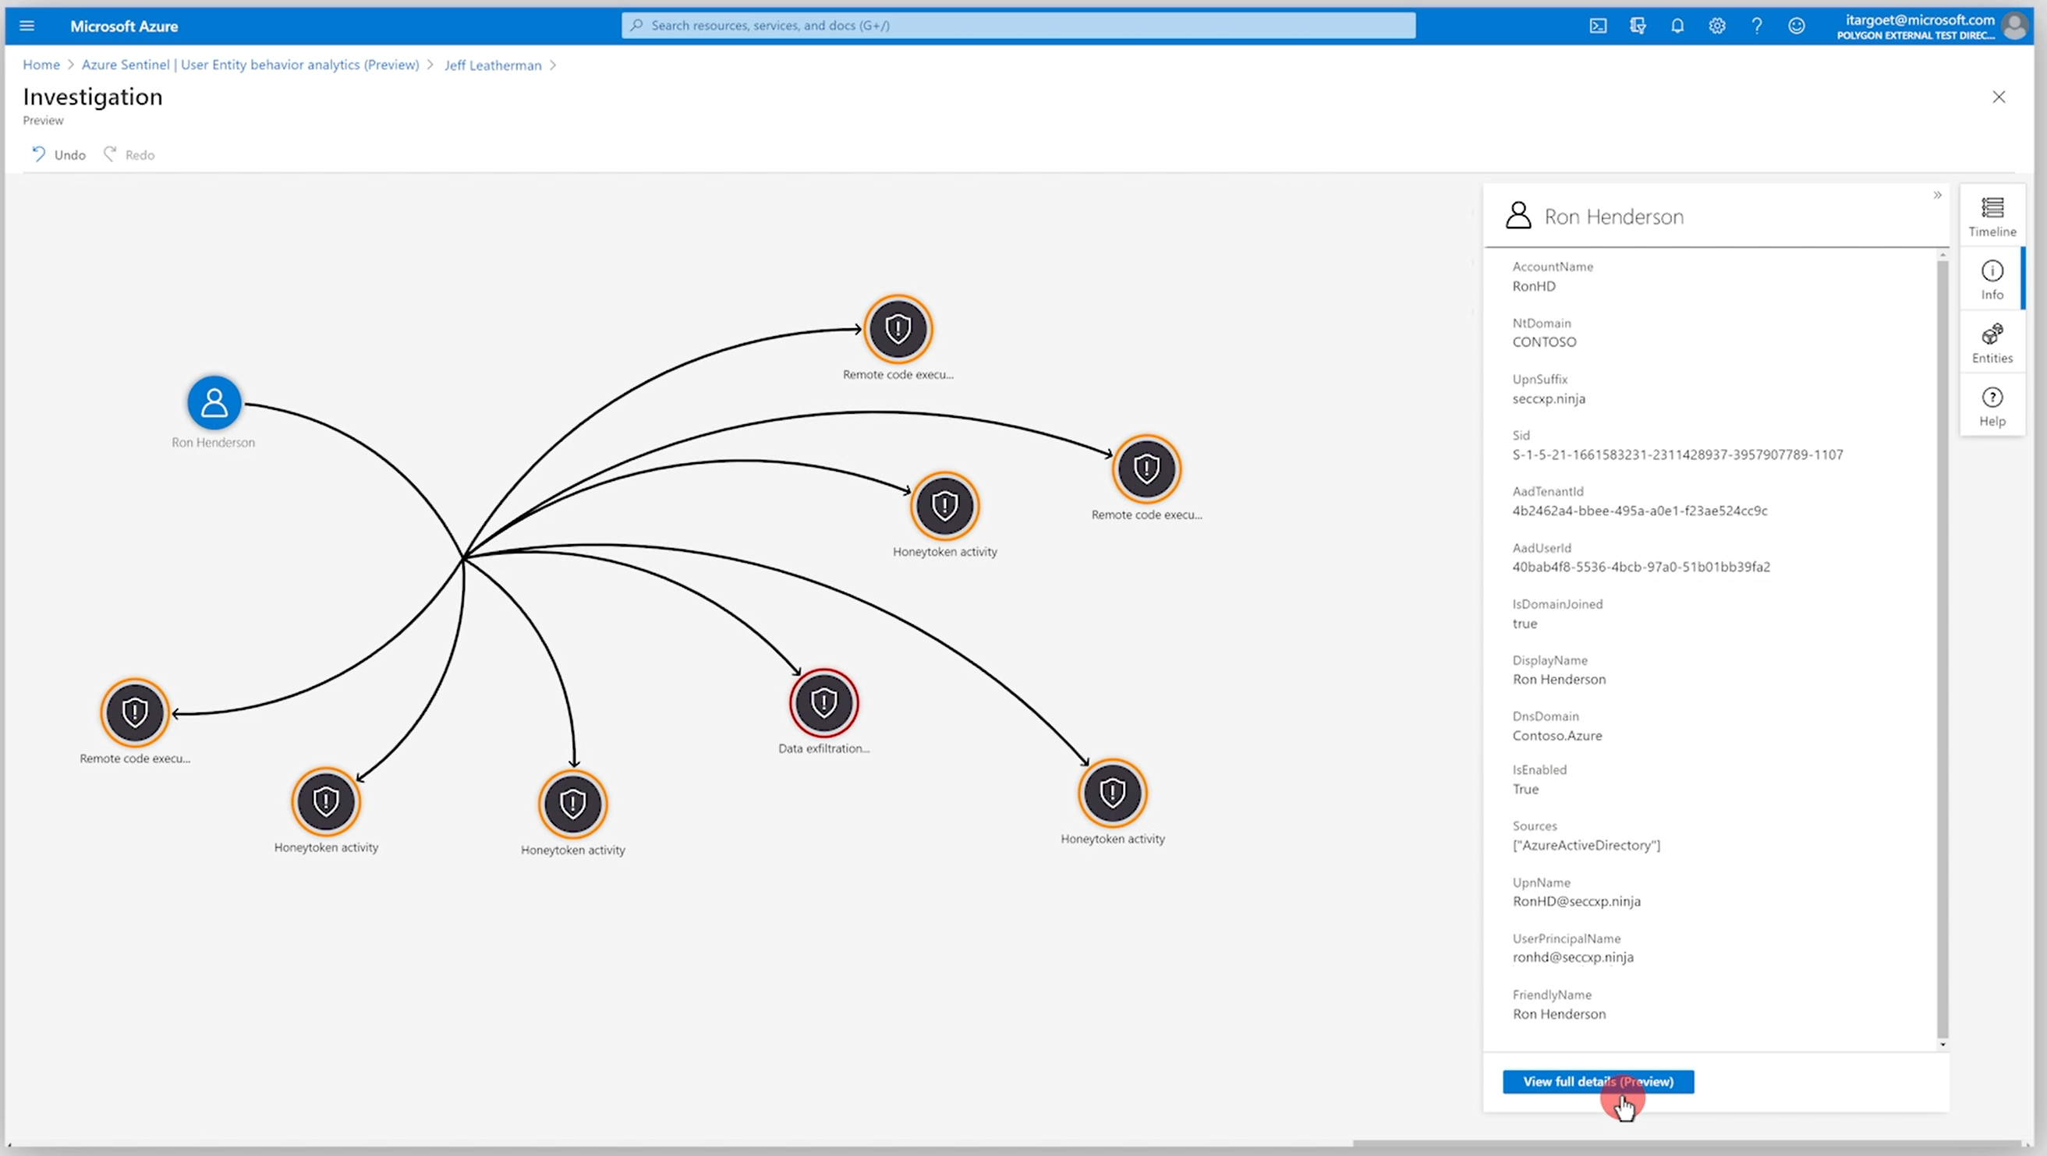

Slide 29
Azure Sentinel – Threat Intelligence
Azure Sentinel lets you import the threat indicators your organization is using, which can enhance your security analysts' ability to detect and prioritize known threats.
You can stream threat indicators to Azure Sentinel by using one of the integrated threat intelligence platform (TIP) products, connecting to TAXII servers, or by using direct integration with the Microsoft Graph Security tiIndicators API.
Mitre Attack Framework utilize STIX and TAXII feeds to import data.
Notes:
TODO

Slide 30
Microsoft Graph - tiIndicator
The Microsoft Graph Security API tiIndicators entity allows you to upload your threat indicators to Microsoft security tools for the actions of allow, block, or alert.
TargetProduct can be Azure Sentinel or Microsoft Defender
Limit of 15000 indicators per tenant
The following indicator types are supported:
Files
IP addresses: Microsoft Defender ATP supports destination IPv4/IPv6 only – set property in networkDestinationIPv4 or networkDestinationIPv6 properties
URLs/domains
Notes:
https://docs.microsoft.com/en-us/graph/api/resources/tiindicator?view=graph-rest-beta

Slide 31
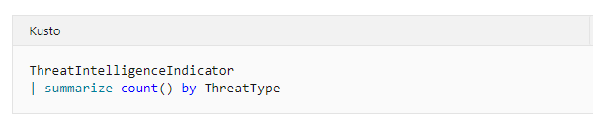
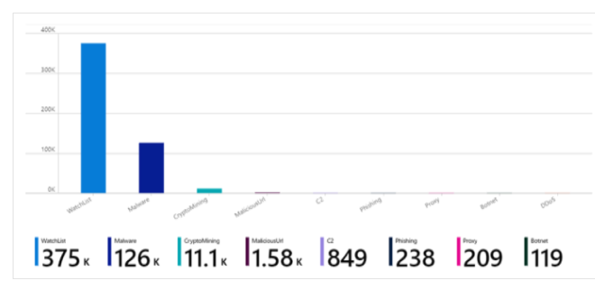
Threat Intelligence Storage
Once imported, Threat Intelligence data is stored in Log Analytics and can be queried:
Notes:
https://docs.microsoft.com/en-us/graph/api/resources/tiindicator?view=graph-rest-beta

Slide 32
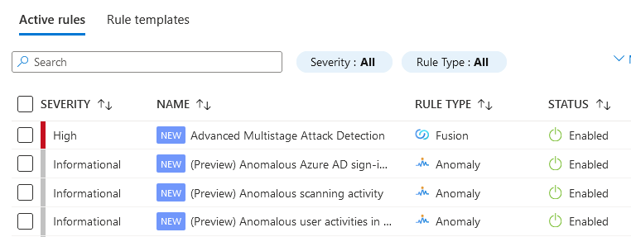
Azure Sentinel – Analytics
Azure Sentinel provides out-of-the-box, built-in templates to help you create threat detection rules.
These templates were designed by Microsoft's team of security experts and analysts based on known threats, common attack vectors, and suspicious activity escalation chains.
Rules created from these templates will automatically search across your environment for any activity that looks suspicious.
Many of the templates can be customized to search for activities, or filter them out, according to your needs.
The alerts generated by these rules will create incidents that you can assign and investigate in your environment.
Notes:
TODO

Slide 33
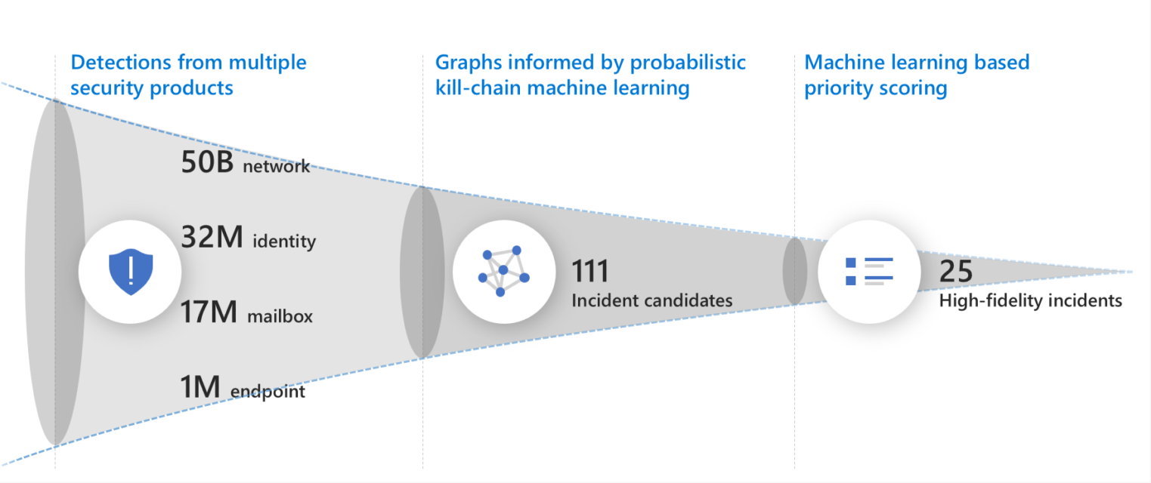
Azure Sentinel – Fusion
Based on Fusion technology, advanced multistage attack detection in Azure Sentinel uses scalable machine learning algorithms that can correlate many low-fidelity alerts and events across multiple products into high-fidelity and actionable incidents.
Notes:
https://docs.microsoft.com/en-us/azure/sentinel/tutorial-detect-threats-built-in?WT.mc_id=Portal-Microsoft_Azure_Security_Insights

Slide 34
Azure Sentinel – Fusion
Fusion is enabled by default.
Because the logic is hidden and therefore not customizable, you can only create one rule with this template.
Fusion engine can correlate alerts produced by scheduled analytics rules with those from other systems, producing high-fidelity incidents as a result. Total of 90 Fusion incident types detected, which require specific connectors to be enabled.
By creating and enabling any rules based on the ML behavior analytics templates, you give Microsoft permission to copy ingested data outside of your Azure Sentinel workspace's geography as necessary for processing by the machine learning engines and models.
Notes:
https://docs.microsoft.com/en-us/azure/sentinel/tutorial-detect-threats-built-in?WT.mc_id=Portal-Microsoft_Azure_Security_Insights

Slide 35
Azure Sentinel – Anomaly
Inevitably attacks should result in unusual behavior in the systems being attacked.
Azure Sentinel's SOC-ML machine learning-based anomalies can identify this behavior with analytics rule templates. Anomaly rule templates use SOC-ML (machine learning) to detect specific types of anomalous behavior.
Anomalies can be powerful tools, but they are notoriously very noisy. They typically require a lot of tedious tuning for specific environments or complex post-processing.
Azure Sentinel SOC-ML anomaly templates are tuned by our data science team to provide out-of-the box value, but should you need to tune them further, the process is simple and requires no knowledge of machine learning.
Each rule has its own unique parameters and thresholds, appropriate to the behavior being analyzed.
While its configuration can't be changed or fine-tuned, you can duplicate the rule, change and fine-tune the duplicate, run the duplicate in Flighting mode and the original concurrently in Production mode, compare results, and switch the duplicate to Production if and when its fine-tuning is to your liking.
Notes:
https://docs.microsoft.com/en-us/azure/sentinel/tutorial-detect-threats-built-in?WT.mc_id=Portal-Microsoft_Azure_Security_Insights
https://docs.microsoft.com/en-us/azure/sentinel/soc-ml-anomalies

Slide 36
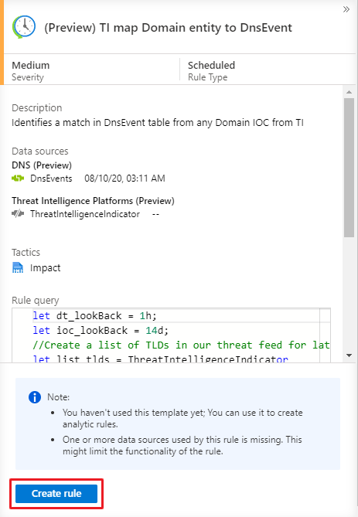
Azure Sentinel – Scheduled
Scheduled analytics rules are based on built-in queries written by Microsoft security experts. You can see the query logic and make changes to it. You can use the scheduled rules template and customize the query logic and scheduling settings to create new rules.
Rule scheduling options include configuring the rule to run every specified number of minutes, hours, or days, with the clock starting when you enable the rule.
We recommend being mindful of when you enable a new or edited analytics rule to ensure that the rules will get the new stack of incidents in time.
For example, you might want to run a rule in synch with when your SOC analysts begin their workday, and enable the rules then.
Notes:
https://docs.microsoft.com/en-us/azure/sentinel/tutorial-detect-threats-built-in?WT.mc_id=Portal-Microsoft_Azure_Security_Insights
You can easily export your rule to an Azure Resource Manager (ARM) template if you want to manage and deploy your rules as code. You can also import rules from template files in order to view and edit them in the user interface.

Slide 37
Azure Sentinel – Watchlist
Azure Sentinel watchlists enable the collection of data from external data sources for correlation with the events in your Azure Sentinel environment.
Once created, you can use watchlists in your search, detection rules, threat hunting, and response playbooks.
Watchlists are stored in your Azure Sentinel workspace as name-value pairs and are cached for optimal query performance and low latency. Use for:
Investigating threats. Responding to incidents quickly with the rapid import of IP addresses, file hashes, and other data from CSV files.
Importing business data as a watchlist. For example, import user lists with privileged system access, or terminated employees, and then use the watchlist to create allow and deny lists used to detect or prevent those users from logging in to the network.
Reducing alert fatigue. Create allow lists to suppress alerts from a group of users, such as users from authorized IP addresses that perform tasks that would normally trigger the alert, and prevent benign events from becoming alerts.
Enriching event data. Use watchlists to enrich your event data with name-value combinations derived from external data sources.
Notes:
TODO

Slide 38
Azure Sentinel – Automation
Automation rules allow you to centrally manage all the automation of incident handling.
Automation rules streamline automation use in Azure Sentinel and enable you to simplify complex workflows for your incident orchestration processes.
Automation rules are triggered by the creation of incidents.
You can set conditions to govern when actions will run, based on the incident and entity details and on analytics rules. You can also set the order of actions and the rule’s expiration time.
Use Automation Rules to:
Automate incident configuration - Directly set incident status or severity, assign an owner, or add a tag when an incident is created, without the need for running a playbook.
Trigger playbooks for Microsoft Providers - Automate the handling of Microsoft security alerts by applying rules to incidents created from the alerts.
Run playbooks on incidents - You can still run playbooks from your automation rules to integrate with other services or create complex logic chains. The rules pass the incidents to playbooks with all their details, including alerts and entities.
Apply incident suppression - You can use rules to automatically resolve incidents that are known false/benign positives – for example, when running penetration tests, doing scheduled maintenance or upgrades, or testing automation procedures.
Notes:
TODO

Slide 39
Azure Sentinel – Solutions
Azure Sentinel solutions provide in-product discoverability, single-step deployment, and enablement of end-to-end product, domain, and/or vertical scenarios in Azure Sentinel.
This experience is powered by Azure Marketplace for solutions’ discoverability, deployment, and enablement, and by Microsoft Partner Center for solutions’ authoring and publishing.
Customers can easily discover packaged content and integrations that deliver value for a product, domain, or vertical within Azure Sentinel.
Customers can easily deploy content in a single step, and optionally enable content to get started immediately.
Providers or partners can deliver combined product or domain or vertical value using solutions in Azure Sentinel, and also be able to productize investments.
https://docs.microsoft.com/en-us/azure/sentinel/sentinel-solutions
https://docs.microsoft.com/en-us/azure/sentinel/sentinel-solutions-deploy
Notes:
https://docs.microsoft.com/en-us/azure/sentinel/sentinel-solutions
https://docs.microsoft.com/en-us/azure/sentinel/sentinel-solutions-deploy
https://techcommunity.microsoft.com/t5/azure-sentinel/introducing-azure-sentinel-solutions/ba-p/2347312

Slide 40
Azure Sentinel – SIEM Integration
Enrich the insights you get with Azure Sentinel by bringing in alerts from your current SIEM.
Azure Sentinel’s built-in machine learning models can help reduce the false positives you’re seeing in your current SIEM, and enable your security team focus on only the alerts that matter.
You can connect your existing SIEM to Azure Sentinel in two ways:
If your current SIEM uses CEF for alerts or events, Azure Sentinel has a native CEF connector
If you are using a log forwarder, utilize the Logstash connector for Log Analytics to forward logs to Azure Sentinel
If your team is more comfortable working within your existing SIEM, Microsoft Security Graph API can serve to connect Azure Sentinel to your current toolset.
Security Graph API allows you to integrate Microsoft alerts into numerous 3rd party tools, including other SIEMs.
Notes:
https://techcommunity.microsoft.com/t5/azure-sentinel/try-azure-sentinel-alongside-your-existing-siem/ba-p/912965

Slide 41
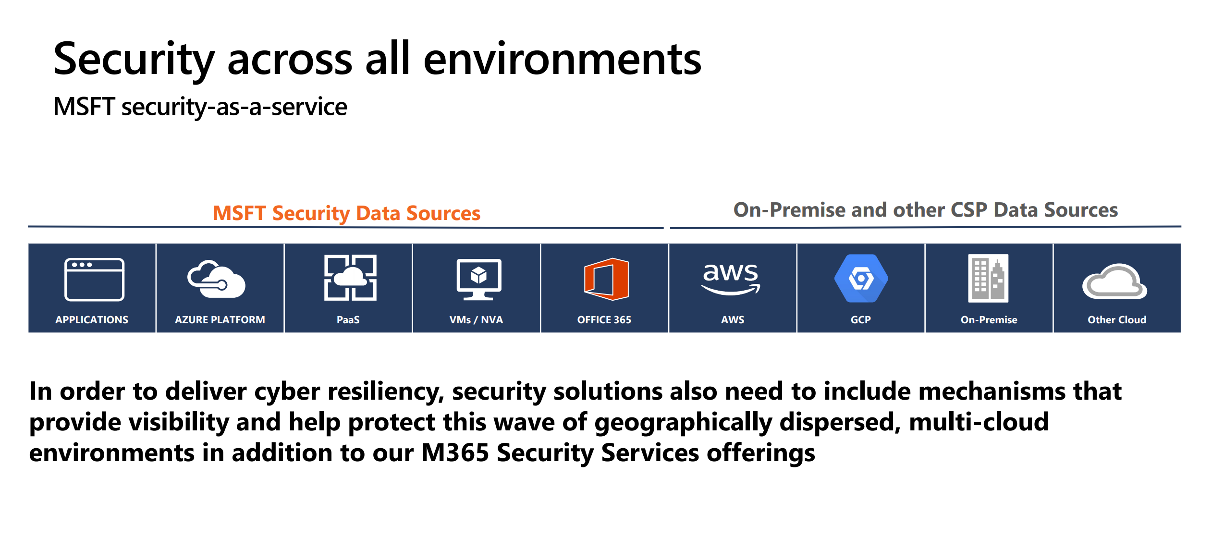

Slide 42
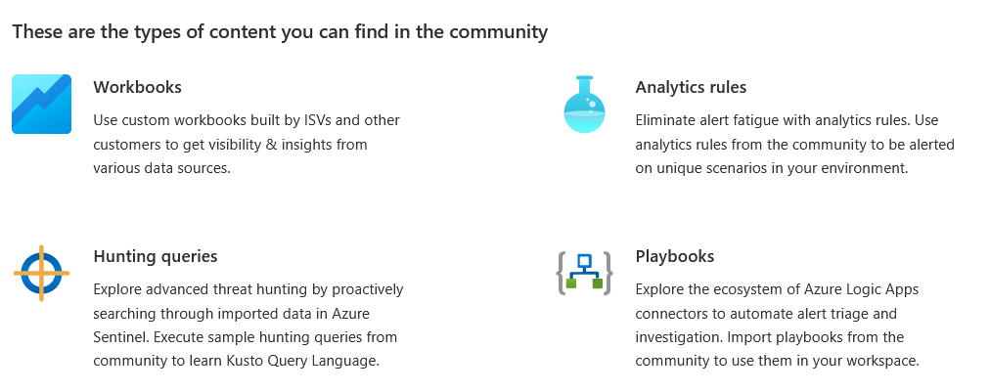
Azure Sentinel – Community
Open source community (https://github.com/Azure/Azure-Sentinel) to facilitate collaboration among customers and partners using GitHub. ​ Explore sample content for alert rules, Add-ons, playbooks and more.
Join the Azure Sentinel community to interact with other customers and experts to learn, provide feedback and share knowledge about Azure Sentinel.
Notes:
TODO

Slide 43
Migrating to Sentinel

Slide 44
Migration to Azure Sentinel
TODO

Slide 45
Example: Splunk
TODO

Slide 46
Security Operations Center

Slide 47
The Golden Hour
The golden hour, also known as golden time, refers to the period of time following a traumatic injury during which there is the highest likelihood that prompt medical and surgical treatment will prevent death.
Expression used to show how important it is to respond to/repair a cybersecurity threat in the first hour.
In the last few years (WannaCry, Petya, Bad Rabbit, etc.), the "golden hour" concept just doesn't hold.
We need to do our best to prevent attacks from happening in the first place!
Notes:
The Golden Hour remake - Defining metrics for a successful security operations - Microsoft Tech Community

Slide 48
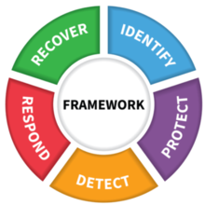
Security Operations Center
Security operations maintain and restores the security assurances of the system as live adversaries attack it. The tasks of security operations are described well by the NIST Cybersecurity Framework functions of Detect, Respond, and Recover.
Detect - Security operations must detect the presence of adversaries in the system, who are incented to stay hidden in most cases as this allows them to achieve their objectives unimpeded. This can take the form of reacting to an alert of suspicious activity or proactively hunting for anomalous events in the enterprise activity logs.
Respond – Upon detection of potential adversary action or campaign, security operations must rapidly investigate to identify whether it is an actual attack (true positive) or a false alarm (false positive) and then enumerate the scope and goal of the adversary operation.
Recover – The ultimate goal of security operations is to preserve or restore the security assurances (confidentiality, integrity, availability) of business services during and after an attack.
Notes:
Security operations in Azure | Microsoft Docs

Slide 49

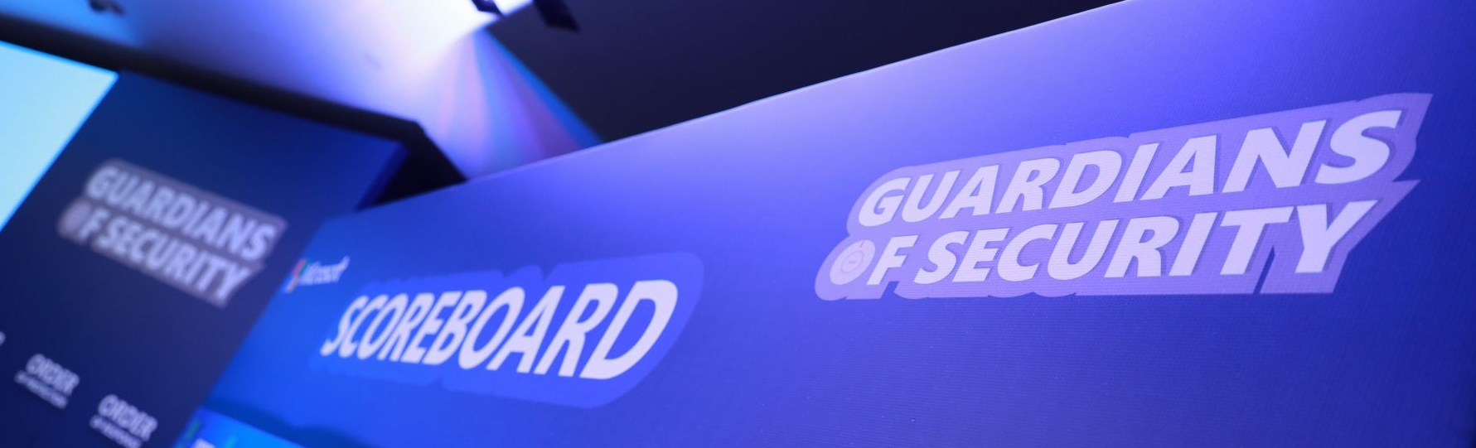
Doing a good job?
So how do you know that you are doing a good job?
My job is to "clean" the queue (SIEM/Product Specific)
We are overwhelmed anyway so we are doing what we can.
As long as there is no breach on my network, I am doing my job
As long as my company is not on the front page of the newspaper I’m fine
Notes:
TODO

Slide 50
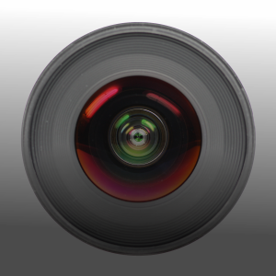
Focus Areas
Known knowns - Could be solved or dramatically reduced by implementing a vulnerability management program, exploit mitigations, secure configuration (fix all misconfiguration, security hardening), and by building secure perimeters (network perimeter, physical devices, application control, etc.).
Known unknowns - In this area our mindset should be, "We haven't seen this before, but we have the tools to stop it". We should take into consideration solutions like machine learning-driven next-generation antimalware, automatic containment (i.e., conditional access), and automatic investigation and remediation solutions to reduce risk as fast as possible
Unknown unknowns - In this area we should focus on visibility and expert assistance: best-in-class endpoint detection and response (EDR) solution and managed detection and response (MDR) services that have your back
Notes:
The Golden Hour remake - Defining metrics for a successful security operations - Microsoft Tech Community

Slide 51
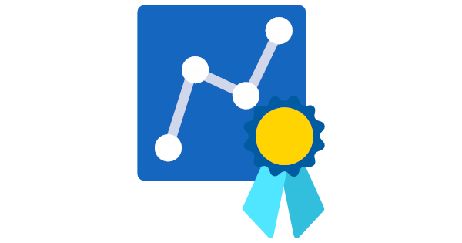
Success Metrics
Security operators, incident responders, or security analysts should all have an easy way to evaluate their work. Common KPIs include:
Mean time to detect - The average time it takes to recognize a threat
Mean time to Investigate - The average time it takes to analyze the potential threat and identify if any further response actions are needed
Mean time to respond - the average time it takes to response and stop a potential threat from spreading or creating any damage.
Mean time to repair/recover - The average time it takes to restore to normal operations
Notes:
TODO

Slide 52
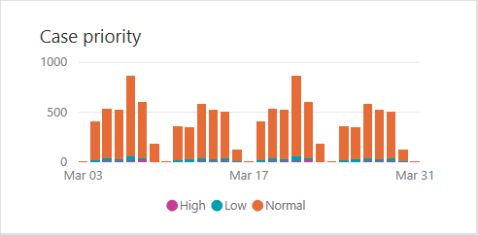
Prioritizing Alert and Log Interaction
Ensure that you are integrating critical security alerts and logs into SIEMs without introducing a high volume of low value data.
Introducing too much low value data can increase SIEM cost, increase noise and false positives, and lower performance.
The data you collect should be focused on supporting one or more of these operations activities:
Alerts (detections from existing tools or data required for generating custom alerts)
Investigation of an incident (for example, required for common queries)
Proactive hunting activities
Notes:
Security operations in Azure | Microsoft Docs

Slide 53
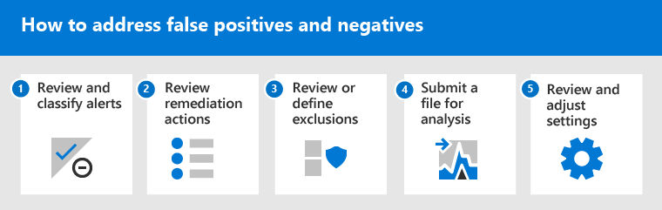
False Positive and Negatives
TODO
Notes:
Address false positives/negatives in Microsoft Defender for Endpoint | Microsoft Docs

Slide 54
Investigation Examples
Phishing – https://docs.microsoft.com/en-us/security/compass/incident-response-playbook-phishing
Password Spray – https://docs.microsoft.com/en-us/security/compass/incident-response-playbook-password-spray
App Consent - https://docs.microsoft.com/en-us/security/compass/incident-response-playbook-app-consent
Notes:
https://docs.microsoft.com/en-us/security/compass/incident-response-playbook-phishing
https://docs.microsoft.com/en-us/security/compass/incident-response-playbook-password-spray
https://docs.microsoft.com/en-us/security/compass/incident-response-playbook-app-consent

Slide 55
Microsoft + Security Operations

Slide 56
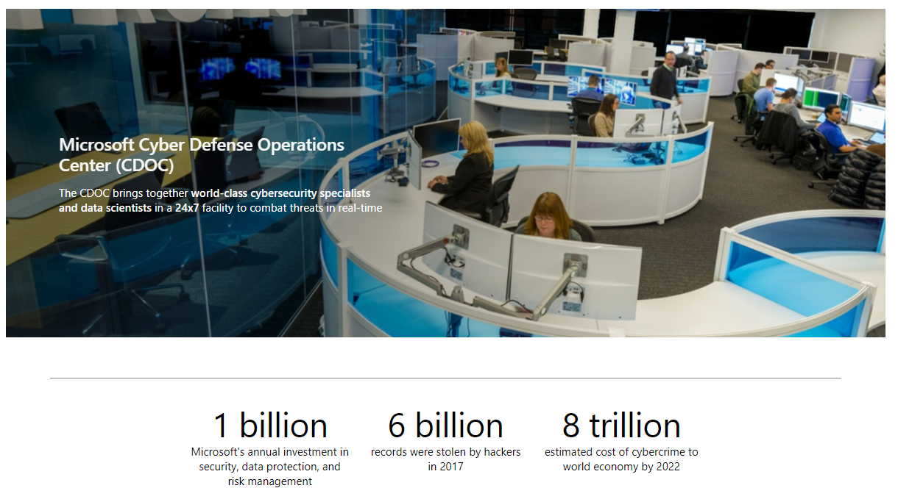
Microsoft Cyber Defense Operations Center (CDOC)
Notes:
https://www.microsoft.com/en-us/msrc/cdoc

Slide 57


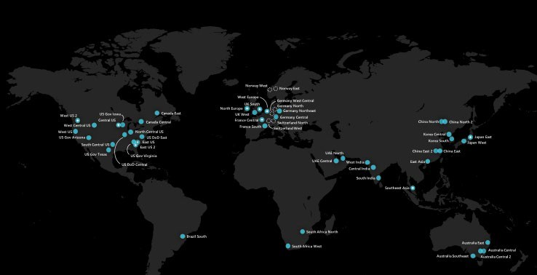
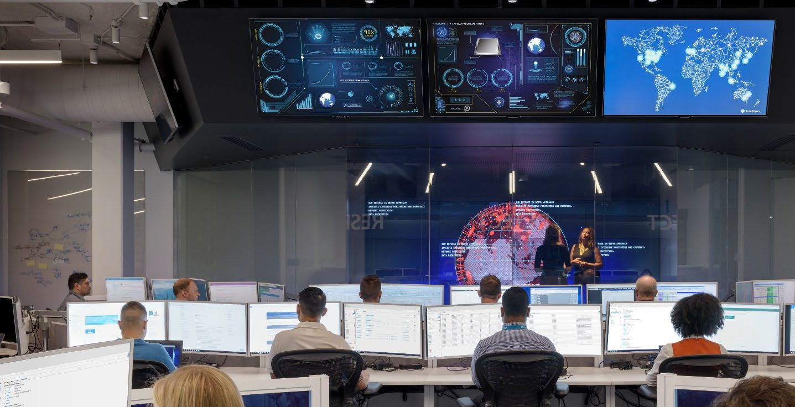
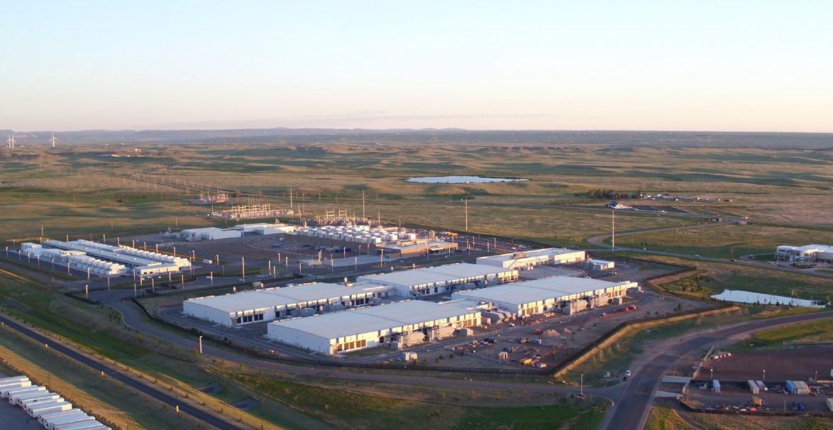





GlobAL
Secure & Compliant
Industrial Facilities
60+
Azure regions, the largest geographical footprint of any cloud provider
8th
Generation of Design, building Datacenters since 1989
Multiple Generations
of DCs in Operation
92
Compliance offerings
Electrical Power Monitoring (EPMS) Building Management (BMS) HVAC Systems
Water Chilling & Fire
Suppression Systems
Diverse Personnel (MS and Non-MS)
Windows & Linux embedded devices, workstations and servers

Slide 58
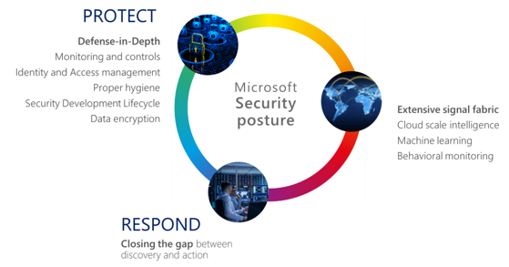
CDOC
The Cyber Defense Operations Center brings together security response experts from across the company to help protect, detect, and respond to threats in real-time. Staffed with dedicated teams 24x7, the Center has direct access to thousands of security professionals, data scientists, and product engineers throughout Microsoft to ensure rapid response and resolution to security threats.
​
Informed by trillions of data points across an extensive network of sensors, devices, authentications, and communications, the Center employs automated software, machine learning, behavioral analysis, and forensics to create an intelligent security graph.
This threat intelligence insight helps our teams connect the dots, then counter with strong containment and coordinated remediation.

Slide 59
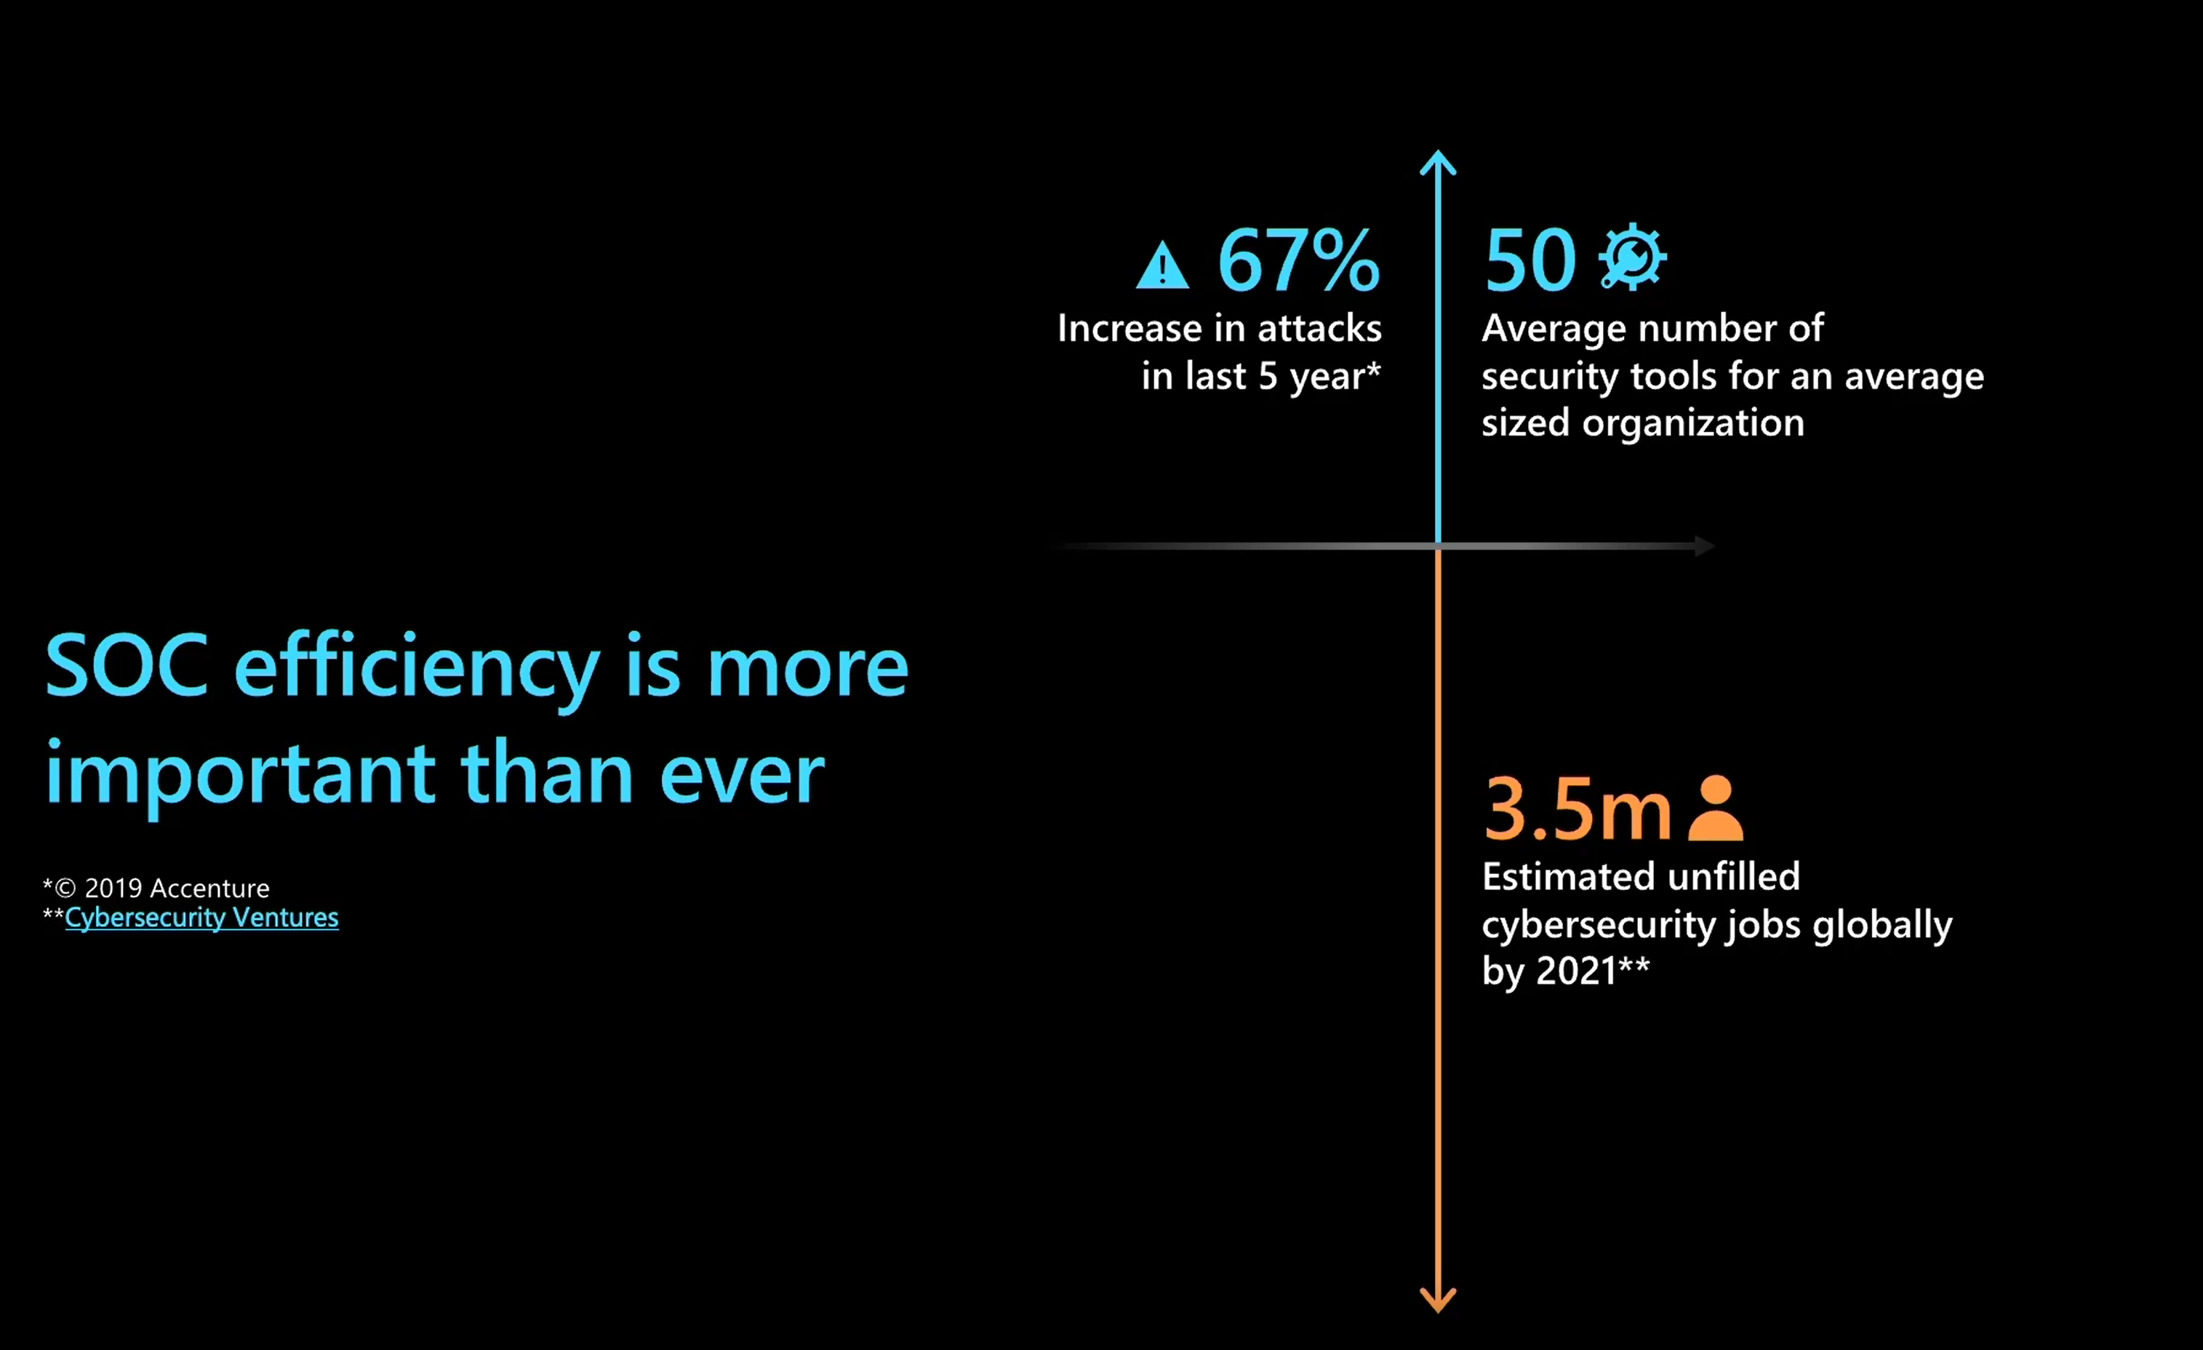

Slide 60
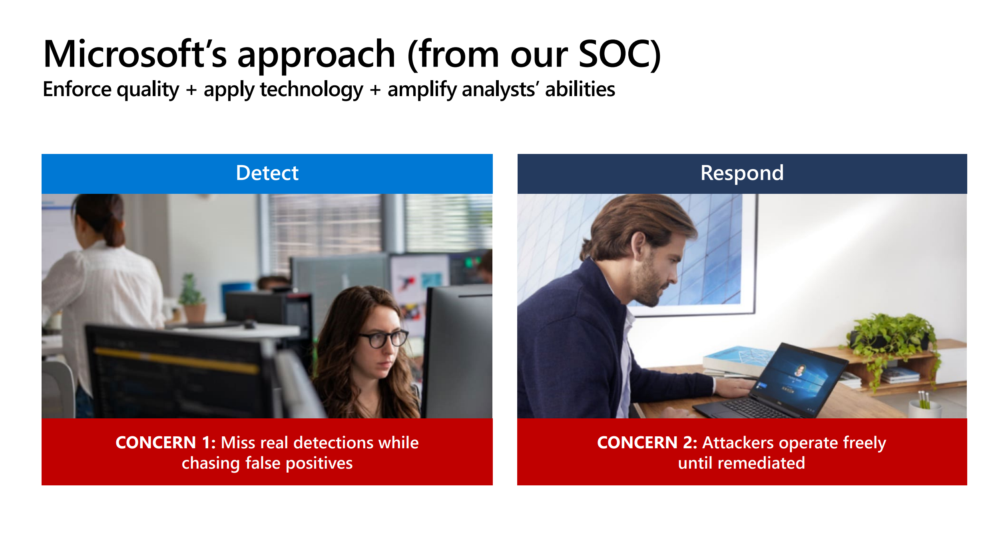

Slide 61
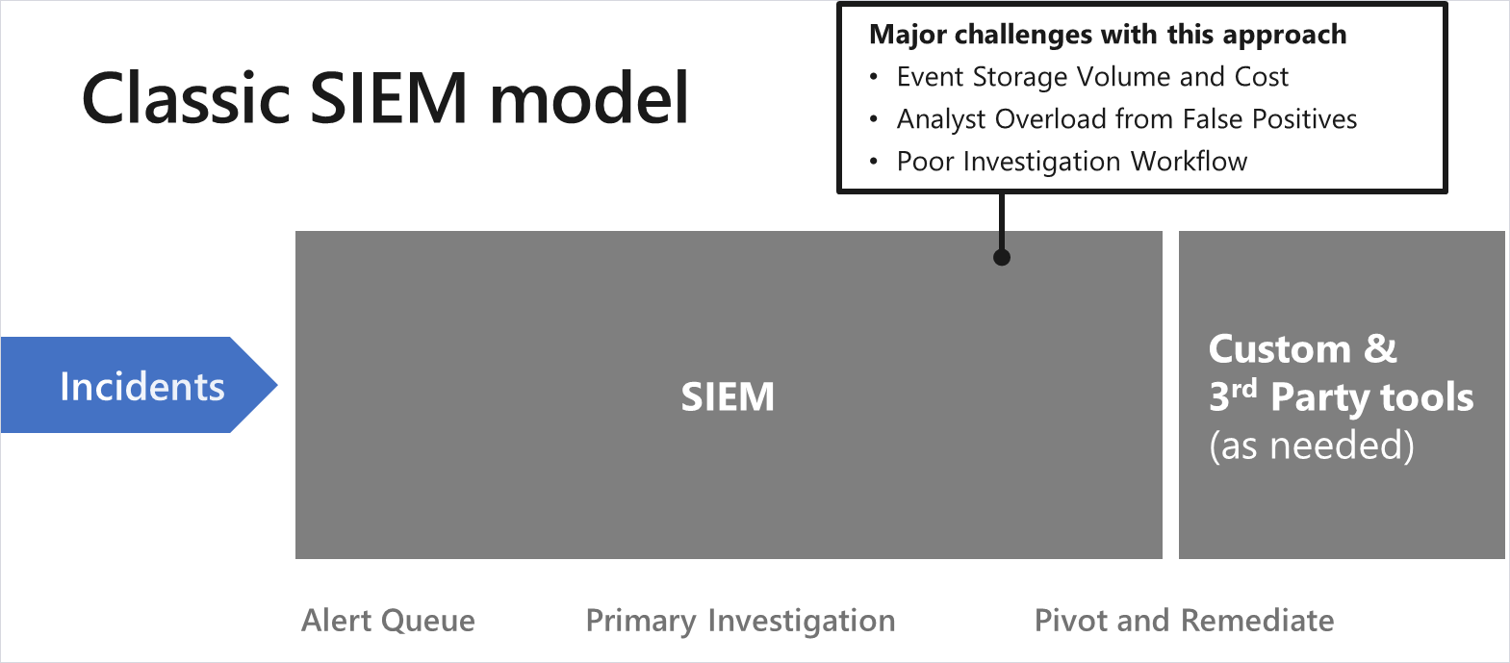
SOC + Traditional Approach
This is the common model where all event data is fed into an on-premises SIEM where analytics are performed on the data (primarily static queries that were refined over time).

Slide 62
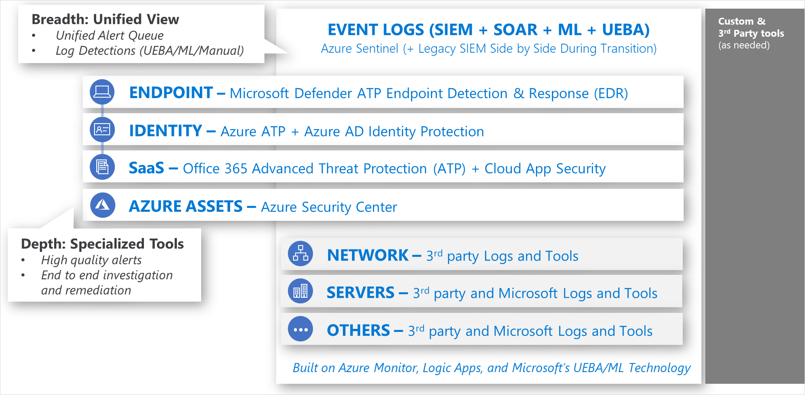
SOC + Modern Approach
A model designed to optimize both breadth (unified view of all events) and depth capabilities.

Slide 63
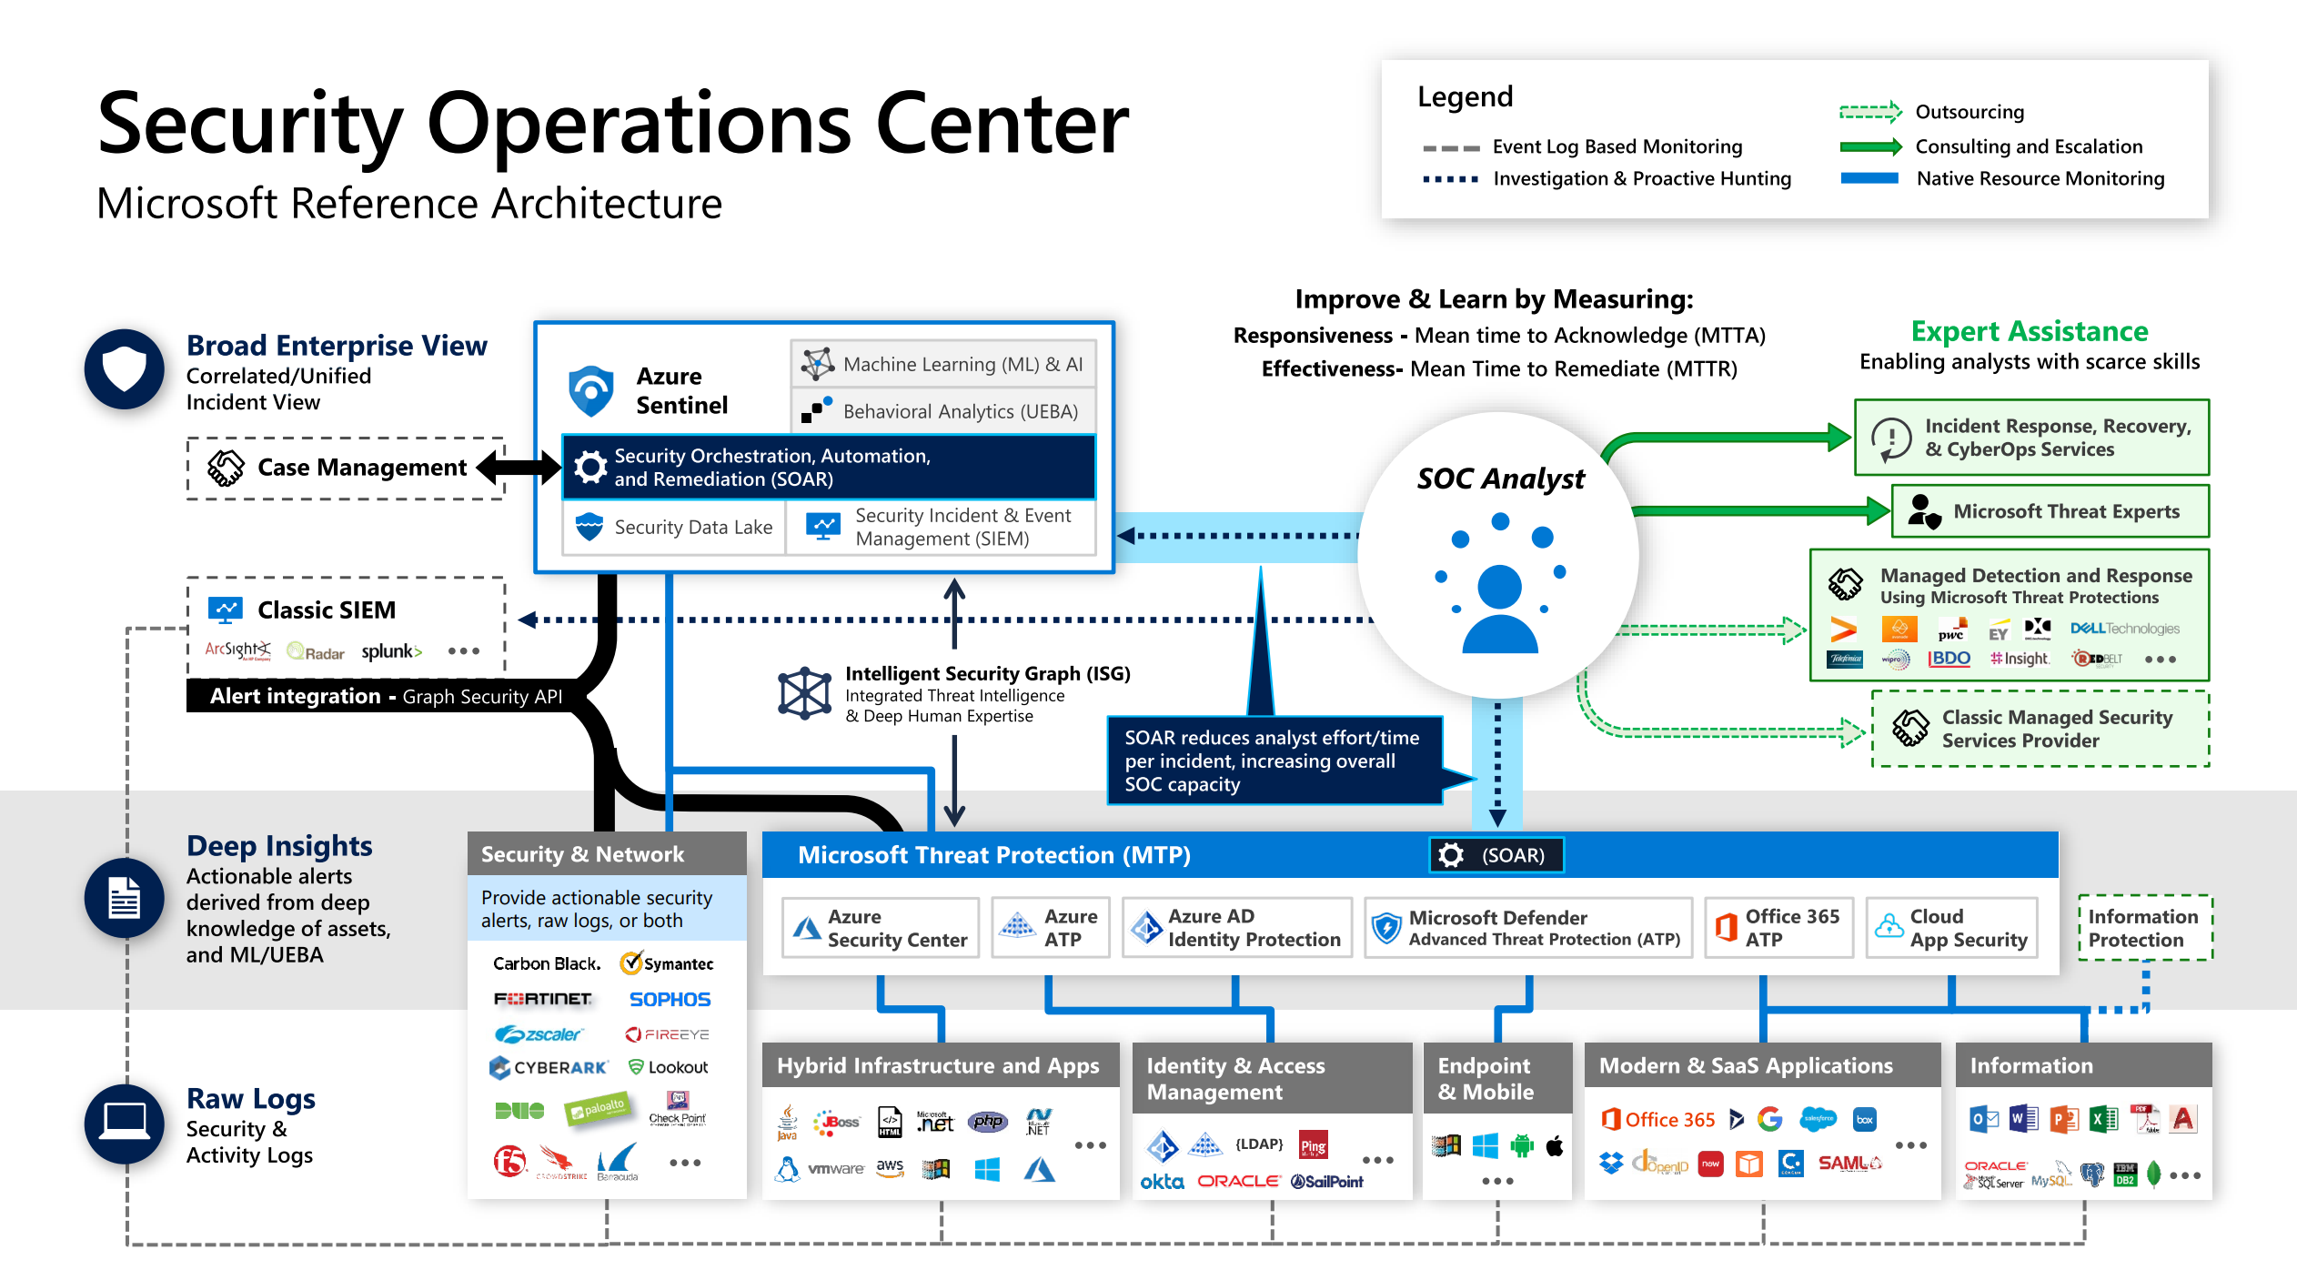

Slide 64
SOC + Tools + Migrating
Expect transitioning to cloud analytics like Azure Sentinel will often include a side-by-side configuration with an existing legacy SIEM.
Short-term transition state—For organizations that are committed to rapidly retiring a legacy SIEM in favor of Azure Sentinel (often to reduce cost/complexity) and need operational continuity during this short bridge period.
Medium-term coexistence—For organizations with significant investment into an on-premises SIEM and/or a longer-term plan for cloud migration. These organization recognize the power of Data Gravity—placing analytics closer to the cloud data will avoid costs and challenges of transferring logs to/from the cloud.
Managing the SOC investigations across the SIEM platforms can be accomplished with reasonable efficiency using either a case management tool or the Microsoft Graph Security API (synchronizing Alerts between the two SIEM platforms).

Slide 65
SOC + Business
Business context (to the SOC) —The SOC needs to understand what is most important to the organization so the team can apply that context to fluid real-time security situations. What would have the most negative impact on the business?
Joint practice exercises (with the SOC)—Business leaders should regularly join the SOC in practicing response to major incidents. This builds the muscle memory and relationships that are critical to fast and effective decision making in the high pressure of real incidents, reducing organizational risk. This practice also reduces risk by exposing gaps and assumptions in the process that can be fixed prior to a real incident.
Major incidents updates (from the SOC)—The SOC should provide updates to business stakeholders for major incidents as they happen. This allows business leaders to understand their risk and take both proactive and reactive steps to manage that risk.
Business intelligence (from the SOC)—Sometimes the SOC finds that adversaries are targeting a system or data set that isn’t expected. As the SOC discovers the targets of attacks, they should share these with business leaders as these signals may trigger insight for business leaders.

Slide 66
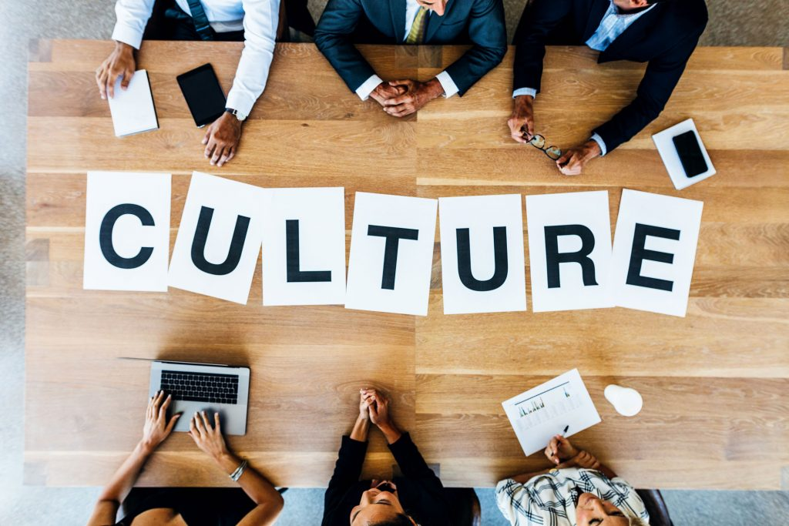
SOC + Culture
Use your human talent wisely—Our people are the most valuable asset we have in the SOC and we can’t afford to waste their time on repetitive thoughtless tasks that can be automated.
Teamwork—We’ve learned that we can’t tolerate the “lone hero” mindset in the SOC, nobody is as smart as all of us together. Teamwork makes a high-pressure working environment like the SOC much more fun, enjoyable, and productive when everyone knows they’re on the same team and everyone has each other’s back. We design our processes and tools to divide up tasks into specialties and to encourage people to share insights, coordinate and check each other’s work, and constantly learn from each other.
Shift left mindset—To get and stay ahead of cybercriminals and hackers who constantly evolve their techniques, we must continuously improve and shift our activities “left” in the attack timeline. We focus on speed and efficiency to try and get “faster than the speed of attack” by looking at ways we could have detected attacks earlier and responded more quickly.

Slide 67
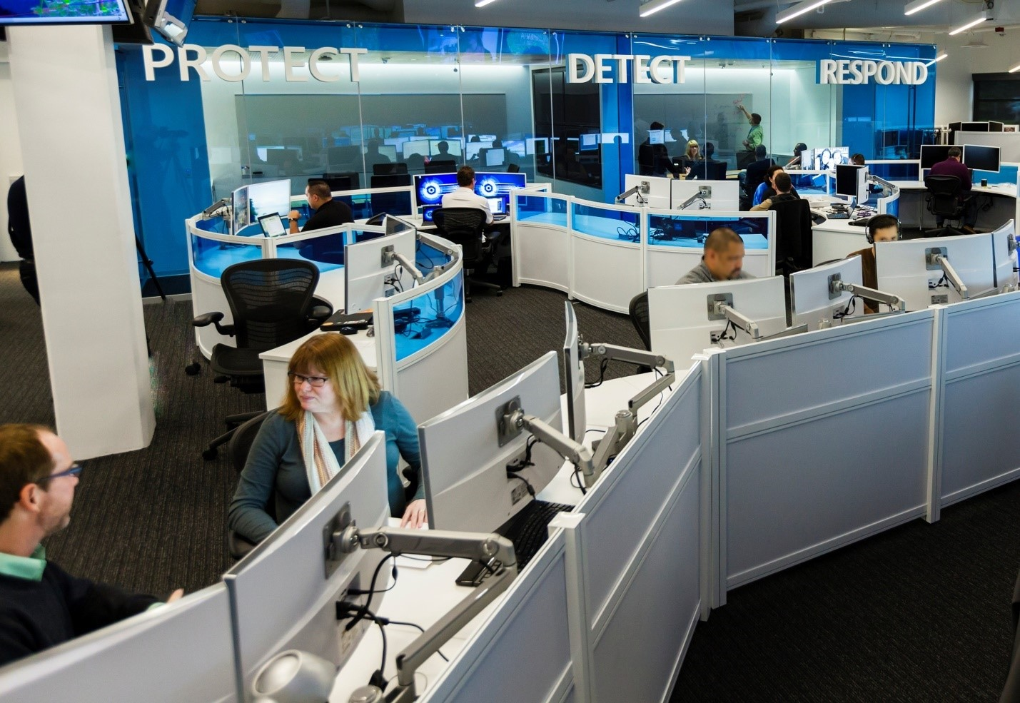
SOC + People
People are the most valuable asset in the SOC—their experience, skill, insight, creativity, and resourcefulness are what makes our SOC effective.
Our SOC management team spends a lot of time thinking about how to ensure our people are set up with what they need to succeed and stay engaged.
As we’ve improved our processes, we’ve been able to decrease the time it takes to ramp people up and increase employee enjoyment of their jobs.
Two aspects of how to set up people in the SOC for success:
Empower humans with automation.
Microsoft SOC teams and tiers model.

Slide 68

SOC + Automation
Automation is not about using efficiency to remove humans from the process—it is about empowering humans.
Think about how we can automate repetitive tasks from the analyst’s job, so they can focus on the complex problems that people are uniquely able to solve.
Automation empowers humans to do more in the SOC by increasing response speed and capturing human expertise.
The toil our staff experiences comes mostly from repetitive tasks and repetitive tasks come from either attackers or defenders doing the same things over and over.
Repetitive tasks are ideal candidates for automation.

Slide 69
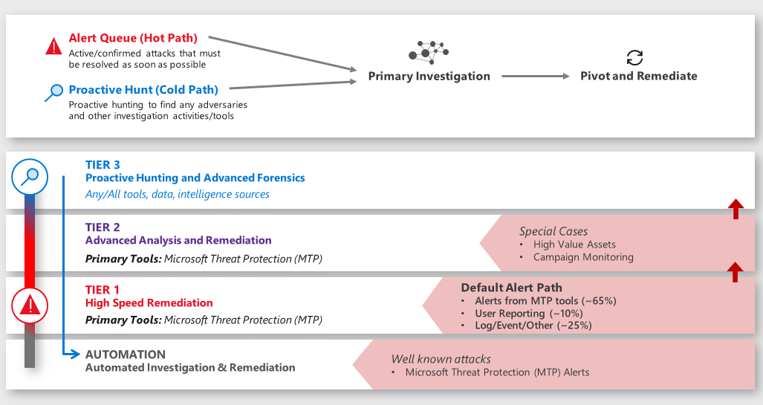
SOC + Teams and Tiers
Operates with three tiers of analysts plus automation:

Slide 70
SOC + Tier 1
This team is the primary front line for and focuses on high-speed remediation over a large volume of incidents.
Tier 1 analysts respond to a very specific set of alert sources and follow prescriptive instructions to investigate, remediate, and document the incidents.
The rule of thumb for alerts that Tier 1 handles is that it can be typically remediated within seconds to minutes.
The incidents will be escalated to Tier 2 if the incident isn’t covered by a documented Tier 1 procedure or it requires involved/advanced remediation

Slide 71
SOC + Tier 2
This team is focused on incidents that require deeper analysis and remediation.
Many Tier 2 incidents have been escalated from Tier 1 analysts, but Tier 2 also directly monitors alerts for sensitive assets and known attacker campaigns.
These incidents are usually more complex and require an approach that is still structured, but much more flexible than Tier 1 procedures.
Additionally, some Tier 2 analysts also proactively hunt for adversaries (typically using lower priority alerts from the same Microsoft Threat Protection tools they use to manage reactive incidents).

Slide 72
SOC + Tier 3
This team is focused primarily on advanced hunting and sophisticated analysis to identify anomalies that may indicate advanced adversaries.
Most incidents are remediated at Tiers 1 and 2 (96 percent) and only unprecedented findings or deviations from norms are escalated to Tier 3 teams.
Tier 3 team members have a high degree of freedom to bring their different skills, backgrounds, and approaches to the goal of ferreting out red team/hidden adversaries.
Tier 3 team members have backgrounds as security professionals, data scientists, intelligence analysts, and more.
These teams use different tools (Microsoft, custom, and third-party) to sift through a number of different datasets to uncover hidden adversary activity.
A favorite of many analysts is the use of Kusto Query Language (KQL) queries across Microsoft Threat Protection tool datasets.

Slide 73
SOC + Tier 3 Functions
Major incident engineering—Handles escalation of incidents from Tier 2. These virtual teams are created as needed to support the duration of the incident and often include both reactive investigations, as well as proactive hunting for additional adversary presence.
External adversary research and threat analysis—Focuses on hunting for adversaries using existing tools and data sources, as well as signals from various external intelligence sources. The team is focused on both hunting for undiscovered adversaries as well as creating and refining alerts and automation.
Purple team operations—A temporary duty assignment where Tier 3 analysts (blue team) are paired with our in-house attack team members (red team) as they perform authorized attacks. We found this purple (red+blue) activity results in high-value learning by both teams, strengthening our overall security posture and resilience. This team is also responsible for the critical task of coordinating with red team to deconflict whether a detection is an authorized red team or a live attacker.
Future operations team—Focuses on future-proofing our technology and processes by building and testing new capabilities.

Slide 74

SOC + Training + Retention
The apprenticeship model to be most effective at rapidly and consistently building skills. The readiness process focuses on building understanding and competency in three domains:
Technical tools/capabilities.
Our organization (mission and assets being protected).
Attackers (motivations, tools, techniques, habits, etc.).
We supplement this apprenticeship model with structured, formal training on topics, such as new products or features and SOC procedures.
We also encourage attendance at conferences and work hard to ensure our staffing model supports these and other learning opportunities, so they aren’t empty promises.
This approach has been successful allowing us to train new Tier 1 analysts in approximately 10–12 weeks and we’re continuously looking for ways to improve our readiness processes.
In addition, our staffing approach has been critical at mitigating burnout risk.

Slide 75
SOC + Metrics
Time to acknowledge (TTA)—Responsiveness is one of the few elements the SOC has direct control over. We measure the time between an alert being raised (“light starts to blink”) and when an analyst acknowledges that alert and begins the investigation.
Time to remediate (TTR)—Much like many SOCs, we track the time to remediate an incident to ensure we’re limiting the time attackers have access to our environment, which drive effectiveness and efficiencies in our SOC processes and tools.
Incidents remediated (manually/with automation)—We measure how many incidents are remediated manually and how many are resolved with automation. This ensures our staffing levels are appropriate and measures the effectiveness of our automation technology.
Escalations between each tier—We track how many incidents escalated between tiers to ensure we accurately capture the workload for each tier. For example, we need to ensure that Tier 1 work on an escalated incident isn’t fully attributed to Tier 2.

Slide 76
Thank You slide
Break

Slide 77
Welcome Back!
7:00-7:05 | Welcome
7:05-7:15 | Keynote
7:15-7:45 | Demo Walkthrough
7:45-8:00 | Break
8:00-9:00 | Data Loading & Data Lake Organization
9:00-10:00 | Activity: Data Lake Design & Security Considerations | Table Group Call
10:00-10:15 | Break
10:15-11:00 | Build Hands-on: Data Integration Part 1 | Table Group Call
11:00-12:00 | Break | Main Call
12:00-12:30 | Data Transformations
12:30-13:00 | Activity: Data Engineering Discussion | Table Group Call
13:00-14:00 | Build Hands-on: Data Integration Part 2
14:00-14:15 | Closing | Main Call
Presentation/
Whole Group
Lab
Activity/ Discussion/ Group Work
Announcements

Slide 78
Better together!

Slide 79
Azure Defender + Azure Sentinel
How does Azure Sentinel work with Azure Defender to provide Analysts the tools they need?
How does Azure Sentinel improve SOC efficiency?

Slide 80


















Microsoft Datacenters and SOC
Data Collection
Correlation & Detection
Incident Response
Critical Infrastructure Environment
Azure Sentinel
Microsoft SOC
Domain controller | AD | Firewall
Physical Hosts | VMs | Network Routers
Connect Diverse Sources
Orchestration
Log Search Across Data Sources
Industrial Control Systems & Industrial IoT Devices (Azure Defender for IoT)
OT+IT Playbooks
Alert Publisher API
Automation
Microsoft Managed Secure Devices
Alerts with Reduced Noise
Case Management
ML Powered Detections Bring Your Own ML
Physical Access
Investigation

Slide 81
Datacenter Security Monitoring & Response System
Improved critical environment Inventory quality for risk-based analysis
Correlate security-significant events across multiple sources
Advanced detections for ICS networks for known malware, botnet, and command and control traffic
Threat Detection with ML Support for Insider threat detection scenario via UEBA
OT+IT Incident Response Processes & Playbooks using LogicApps integrated with Microsoft SOC
Detect Suspicious/Anomalous activity while reducing noise

Slide 82















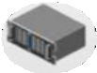


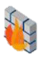
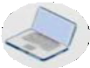
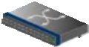
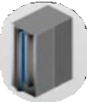





TRITON Kill Chain
Attack on Petrochemical Facility
1
2 3
4
Steal OT credentials
CORPORATE
Remote access to OT network
DMZ
Reprogram safety PLC
PLC & RTU
Disable safety PLC & launch 2nd cyberattack
SCADA
SENSORS & ACTUATOR
Workstation
HMI
Engineering Workstation
Internet
TriStation
col
Proto
Historian
Historian
PLC
Sensors
Actuations
App server
Network
Device
Network
Historian
Printer
Device
RTU
Other
IT OT

Slide 83


Challenges to detecting TRITON
Data availability
Collect logs from multiple sources
Connecting the dots
Connect IT events to OT occurrence
Understanding OT
Apply knowledge of OT systems
Identifying real threats
Detect and prioritize threats from a sea of data

Slide 84
Incident Integration
Incident integration allows you to stream all Microsoft 365 Defender incidents into Azure Sentinel and keep them synchronized between both portals.
Incidents from Microsoft 365 Defender (formerly known as Microsoft Threat Protection or MTP) include all associated alerts, entities, and relevant information, providing you with enough context to perform triage and preliminary investigation in Azure Sentinel.
Once in Sentinel, Incidents will remain bi-directionally synced with Microsoft 365 Defender, allowing you to take advantage of the benefits of both portals in your incident investigation.
Microsoft 365 Defender enriches and groups alerts from multiple Microsoft 365 products, both reducing the size of the SOC’s incident queue and shortening the time to resolve.
Microsoft Defender for Endpoint (formerly Microsoft Defender ATP)
Microsoft Defender for Identity (formerly Azure ATP)
Microsoft Defender for Office 365 (formerly Office 365 ATP)
Microsoft Cloud App Security
Notes:
Microsoft 365 Defender integration with Azure Sentinel | Microsoft Docs

Slide 85
Connectors
Microsoft 365 Defender connector also lets you stream advanced hunting events from Microsoft 365 Defender and its component services into Azure Sentinel.
These tables are built on the same schema that is used in the Microsoft 365 Defender portal, giving you complete access to the full set of advanced hunting events.
Advantages include:
Easily copy your existing Microsoft Defender for Endpoint advanced hunting queries into Azure Sentinel.
Use the raw event logs to provide further insights for your alerts, hunting, and investigation, and correlate these events with events from other data sources in Azure Sentinel.
Store the logs with increased retention, beyond Microsoft Defender for Endpoint or Microsoft 365 Defender’s default retention of 30 days. You can do so by configuring the retention of your workspace or by configuring per-table retention in Log Analytics.
Notes:
Microsoft 365 Defender integration with Azure Sentinel | Microsoft Docs

Slide 86
Sentinel Community
Microsoft 365 Defender connector also lets you stream advanced hunting events from Microsoft 365 Defender and its component services into Azure Sentinel.
These tables are built on the same schema that is used in the Microsoft 365 Defender portal, giving you complete access to the full set of advanced hunting events.
Advantages include:
Easily copy your existing Microsoft Defender for Endpoint advanced hunting queries into Azure Sentinel.
Use the raw event logs to provide further insights for your alerts, hunting, and investigation, and correlate these events with events from other data sources in Azure Sentinel.
Store the logs with increased retention, beyond Microsoft Defender for Endpoint or Microsoft 365 Defender’s default retention of 30 days. You can do so by configuring the retention of your workspace or by configuring per-table retention in Log Analytics.
Notes:
Microsoft 365 Defender integration with Azure Sentinel | Microsoft Docs

Slide 87

End to End Investigations
As the analyst builds this understanding, they must capture a complete record with their conclusions and reasoning/evidence for future use (case reviews, analyst self-education, re-opening cases that are later linked to active attacks, etc.). They capture the common, most relevant details quickly into the case such as:
Alert info: Alert links and Alert timeline
Machine info: Name and ID
User info
Event info
Detection source
Download source
File creation info
Process creation
Installation/Persistence method(s)
Network communication
Dropped files

Slide 88

Hunting - ABH
Assume breach, zero-trust.
Hunting is used to develop a high enough level of confidence that they understand the story and scope of the attack.
ABH - Always Be Hunting.
Notes:
TODO

Slide 89
KQL Unions
Hunting involves taking data from multiple tables and combining it to get a big picture view of an entity.
In most cases, Azure Sentinel Incidents provide you with enough KQL templates to get you to where you need to be, however, in some instances, you may need to write your own.
This is especially true with custom logs and external table joins (as would be the case with anonymized privacy based data)
Notes:
TODO

Slide 90

SOC + Day In The Life of An Analyst + Part I
Alert appears in the queue—After a threat detection tool detects a likely attack, an incident is automatically created. The Mean Time to Acknowledge (MTTA) measurement of SOC responsiveness begins with this timestamp.
Own and orient—The analyst on shift begins by taking ownership of the case and reading through the information available in the case management tool. The timestamp for this is the end of the MTTA responsiveness measurement and begins the Mean Time to Remediate (MTTR) measurement.
Check out the host—Typically, the first priority is to identify affected endpoints so analysts can rapidly get deep insight. Our SOC relies on the Endpoint Detection and Response (EDR) of Microsoft Defender.
Scope out and fill in the timeline—The analyst then builds a full picture and timeline of the related chain of events that led to the alert (which may be an adversary’s attack operation or false alarm positive) by following leads from the first host alert.

Slide 91

Responding
The specific response steps are very dependent on the nature of the attack, but the most common procedures used by our analysts include:
Client endpoints—SOC analysts can isolate a computer and contact the user directly (or IT operations/helpdesk) to have them initiate a reinstallation procedure.
Server or applications—SOC analysts typically work with IT operations and/or application owners to arrange rapid remediation of these resources.
User accounts—We typically reclaim control of these by disabling the account and resetting password for compromised accounts (though these procedures are evolving as a large amount of our users are mostly passwordless using Windows Hello or another form of MFA). Our analysts also explicitly expire all authentication tokens for the user with Microsoft Cloud App Security.
Analysts also review the multi-factor phone number and device enrollment to ensure it hasn’t been hijacked (often contacting the user), and reset this information as needed.
Notes:
TODO

Slide 92
Responding (Cont)
Service Accounts—Because of the high risk of service/business impact, SOC analysts work with the service account owner of record (falling back on IT operations as needed) to arrange rapid remediation of these resources.
Emails—The attack/phishing emails are deleted (and sometimes cleared to prevent recovering of deleted emails), but we always save a copy of original email in the case notes for later search and analysis (headers, content, scripts/attachments, etc.).
Other—Custom actions can also be executed based on the nature of the attack such as revoking application tokens, reconfiguring servers and services, and more.
Notes:
TODO

Slide 93

SOC + Day In The Life of An Analyst + Part II
Decide and act—As the analyst develops a high enough level of confidence that they understand the story and scope of the attack, they quickly shift to planning and executing cleanup actions. While this appears as a separate step in this particular description, our analysts often execute on cleanup operations as they find them.
Post-incident cleanup—Because lessons aren’t actually “learned” unless they change future actions, our analysts always integrate any useful information learned from the investigation back into our systems. Analysts capture these learnings so that we avoid repeating manual work in the future and can rapidly see connections between past and future incidents by the same threat actors. This can take a number of forms, but common procedures include:

Slide 94

Post-Incident
Analysts capture learnings so as to avoid repeating manual work in the future and can rapidly see connections between past and future incidents by the same threat actors.
Common procedures include:
Indicators of Compromise (IoCs)—Our analysts record any applicable IoCs such as file hashes, malicious IP addresses, and email attributes into our threat intelligence systems so that our SOC (and all customers) can benefit from these learnings.
Unknown or unpatched vulnerabilities—Our analysts can initiate processes to ensure that missing security patches are applied, misconfigurations are corrected, and vendors (including Microsoft) are informed of “zero day” vulnerabilities so that they can create security patches for them.
Internal actions such as enabling logging on assets and adding or changing security controls.

Slide 95

Cybersecurity Maturity Model Certification (CMMC)
TODO

Slide 96
Pop Quiz
Which one of these is NOT a component of a Synapse pipeline?
A) I.R.
B)
Linked Service
C)
Table
D) Activity

Slide 97


Question…
How many different methods of loading ADLS can you think of?
What about a Synapse SQL Pool?

Slide 98
Thank You slide
Break

Slide 99
Breakout Activity: Azure Sentinel Considerations
As a result of participating in this activity, you will better be able to design an Azure Sentinel instance.
OUTCOMES
ACTIVITY
60 minutes
Learning Adviser
Table Group Channel
As a team review WWI requirements provided in student guide
Open the whiteboard and as a team answer the provided challenge questions.
The questions are pre-loaded into the whiteboard.
Welcome | Keynote | Demo Walkthrough | Break | Data Loading & Data Lake Organization | Activity: Data Lake Design & Security Considerations | Break | Lab: Data Integration Part 1 | Break | Data Transformations | Activity: Data Engineering Discussion | Lab: Data Integration Part 2 | Closing

Slide 100
Build Hands-on Lab: Azure Sentinel Part 2
As a result of participating in this lab, you will be better able to deploy and configure Azure Sentinel
OUTCOMES
ACTIVITY
60 minutes
Independent
Table Group Channel & CloudLabs Environment
Independently review and complete Exercises 1-4 in the Lab 1 Guide.
Login to your CloudLabs environment and work through a set of tasks you would typically follow in work associated with ingesting and integrating your customer’s data.
The Lab Guide is available in the ‘Files’ tab of the General channel. Engage your Table Group call for support and troubleshooting.
Welcome | Keynote | Demo Walkthrough | Break | Data Loading & Data Lake Organization | Activity: Data Lake Design & Security Considerations | Break | Lab: Data Integration Part 1 | Break | Data Transformations | Activity: Data Engineering Discussion | Lab: Data Integration Part 2 | Closing

Slide 101
Welcome Back!
8:00-8:05 | Welcome | Main Call
8:05-8:15 | Azure Sentinel
8:15-8:45 | Demo Walkthrough
8:45-9:00 | Break
9:00-10:00 | Azure Sentinel Part I
10:00-10:15 | Activity: Azure Sentinel Considerations | Table Group Call
10:15-11:15 | Break
11:15-12:15 | Build Hands-on: Azure Sentinel Part 1
12:15-1:15 | Break | Main Call
1:15-2:15 | Azure Sentinel Part II | Main Call
2:00-3:00 | Activity: Azure Sentinel | Table Group Call
3:00-4:00 | Build Hands-on: Azure Sentinel Part 2
4:00-4:15 | Closing | Main Call
Presentation/
Whole Group
Lab
Activity/ Discussion/ Group Work
Announcements

Slide 102
Thank You slide
Thank you

Slide 103

Full Group Activity: Azure Sentinel
Objective: As a result of participating in this activity, you will better be able to TODO.
What you will be doing: The facilitator will be posting questions to the entire group using an interactive tool called Mentimeter. The answers you post using Mentimeter will then drive the discussion.
Total Activity Time: 30 minutes

Slide 104

Mentimeter Poll
Scan QR Code
or Go to www.menti.com and use code
1183 9575
Notes:
https://www.menti.com/9r2wwujwag

Slide 105

Hands-On Build Activity: Azure Sentinel Part 2
Objective: As a result of participating in this lab, you will be better able to TODO.
What you will be doing: Like the Part 1 exercise, you work individually in your lab environment to complete a set of tasks you would typically follow in work associated with ingesting and integrating your customer’s data. A set of tasks are outlined for you to follow and complete.
Total Activity Time: 60 minutes

Slide 106









Lab: individual lab exercise
Step 1: Go to your table group channel
Step 2: Your Learning Adviser will provide you a unique cloud lab login link
Step 3: Login and begin the lab. Engage your table group via a Microsoft Teams “meet now” call to support each other (meet now button in upper right corner of application)

Slide 107
Closing
Thank you for your participation in today’s Azure Synapse Technical Boot Camp!
We learned:
TODO
TODAY
We will learn to:
TODO
TOMORROW

